Slide 1


Slide 2

Table of contents
01
03
07
13
17
19
20
21
32
43
48
48
49
57
59
66
72
74
75
Message from Chairman of the Board
Overview of Business
Nature of Business
Risk Factors
General Information
Shareholding Structure
Dividend Payment Policy
Management Structure
Corporate Governance
Anti-Corruption Policy
Corporate Social Responsibility
Internal Control
Related Party Transaction
Summary of Financial Information
Management Discussion and Analysis
Directors and Executives’ Profile
Report of the Audit Committee
Report of the Board of Directors on Financial Reporting
Report and Consolidated Financial Statements and Separate Financial Statements
“For further information on the company issuing the securities. The annual information form (56-1)
of a company that is listed in. www.sec.or.th or website : www.krungthai.co.th”

Slide 3

Message from Chairman of the Board
In the recent year 2017, the car rental market continued to witness a considerable growth as seen from rising demand of cars from both Thai clients and foreign corporate clients expanding their businesses into Thailand who really see the advantage of car lease in terms of cost control, budget control, and the benefit of reducing operational workload and costs, as well as the benefit from government subsidisation in effort to stimulate spending in the economic sphere.
The year 2017 still clearly saw a fierce competition in the car rental business, notably among the larger-sized car rental firms which are known to have had tax benefits from the government and to focus on expanding their portfolios to gain bigger portions of the market share. The company realises the necessity in giving precedence to competition in pricing in a larger extent. The move rendered more business opportunities in acquiring a larger number of auctioned car rental contracts from the free market. The market direction that points toward lower rental fees that are not reflecting the real costs will still be the mainstream idea while secondhand car market forecast is inclined to the positive side.
We have found that the government’s “First Car” scheme that ended last year did not adversely affect the sales of secondhand cars. The company did a calculation and spread the proportions of to-sell cars proportionately between 2016 and 2018. The number of cars seen rolling back to the market did not trigger a situation of oversupply. There has been a forecast indicating that the secondhand car market would turn into a positive direction following the ameliorating economic situation thanks to loan granting and facilitations from financial institutions. After the secondhand car market situation floated to the surface, the prices were seen to improve last year.
The company still adheres to the determination to expand our portfolio of rental cars, improve the efficiency of cost management, and proritise better the rendering of particular services
01

Slide 4
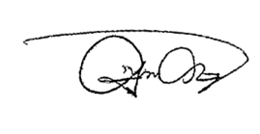
needed by the clients. This can be seen in the improvement in the results of operation of 4.5% with 3.0% increase in net profit in the previous year. As for the secondhand car market, the company last year sold out 13.2% more lease-expired cars, or 1,655 cars in total. In addition, the average sale prices of secondhand cars increased last year by more than 10%, seen in the improvement of 10.9% in the profit from selling out lease-expired cars. As a result, the company’s results of operation considerably improved and its ranking moved up to be one of the top firms in the industry.
In December last year, our subsidiary company opened another secondhand car showroom on Kanchanaphisek road. It is the subsidiary company’s fourth outlet destined to maximise opportunities in selling secondhand cars and efficiency in making profit in selling out lease-expired cars, which helps with the effort to reduce the time of holding cars in stock, reducing the operational costs at the same time. In 2018, the company planned to be more proactive in selling secondhand cars online following technological advancement and changes in consumers’ behaviour.
On behalf of the board of directors, I would like to express my sincere gratitude to all executives and members of staff for their diligence and dedication for the company for the past year. I now promise that the company will maintain its results, operate the business in a true and professional manner, and strengthen its foundation, continuously improving its services in running to the goal. Furthermore, the company will operate its business on the basis of responsibility towards society, community, and environment, so as to grow under the shadowy tree of good governance and sustainable growth.
(Mr.Pithep Chantarasereekul)
Chairman
02

Slide 5
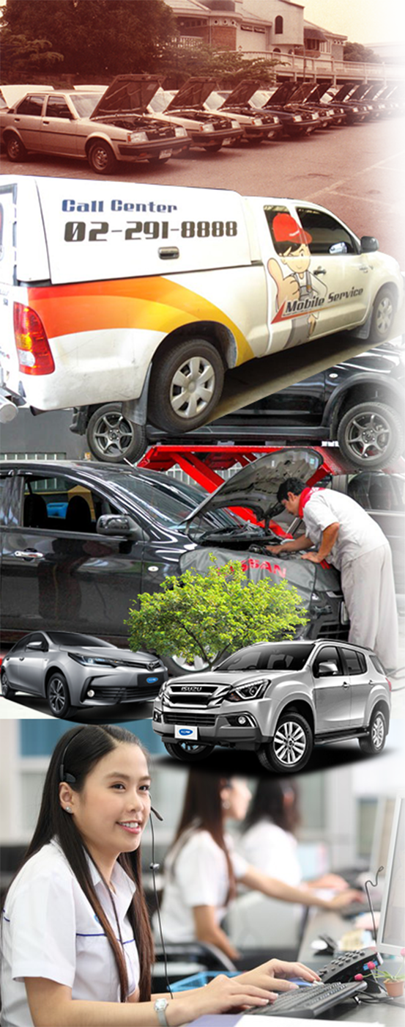
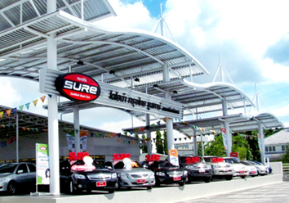
Overview of Business
History and Important Development
Krungthai Car Rent and Lease Public Company Limited registered since January 29, 1992 under the name of “Krungthai Car Rent International Co., Ltd.” by Mr. Paitoon Chantarasereekul with registered capital of Bath 4 million which belonged to Chantarasereekul group for 100%. The Company operated car leasing business both short term (daily-weekly-monthly basis) and long term (operating lease 1-5 years) to corporate customer both government agencies and private companies including individual customers together with the policies of excellent service and customer satisfaction orientation. The Company also worked as partnership and focused on excellent result for all business partners including the improvement of working system to enhance the service quality enabling the solid and continuous growth of the Company.
In August 2004, the Company became a Public Company namely “Krungthai Car Rent and Lease Public Company Limited” and changed in the par value of Baht 1,000 per share to Baht 1 per share. In November 2005, the Company sold 50 million common shares to the public so that the new Company paid-up capital is as of Baht 250 million. The Company was listed on the Stock Exchange of Thailand by December 2005.
In June 2005, the Company invested in Krungthai Automobile Co., Ltd., a subsidiary company, whose nature of business is the sales of used cars and leased cars that have exceeded its leas ability period under the front name of “Toyota Sure”, in which the Company held 37,999,300 baht (accounted to 95% of total shares). As a development, the Company in January 2013 increased its proportion of investment in the subsidiary company to 100% of the total shares.
For the current moment, the subsidiary company owns four branches of used car outlet
1.Headquarters on Kanchanabhisek road
2. Srinagarindra road branch
3.Kaset branch
4. Kanchanaphisek-Baromarachachonani Branch
03

Slide 6
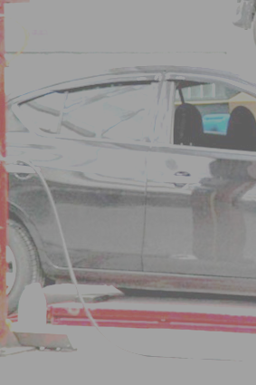
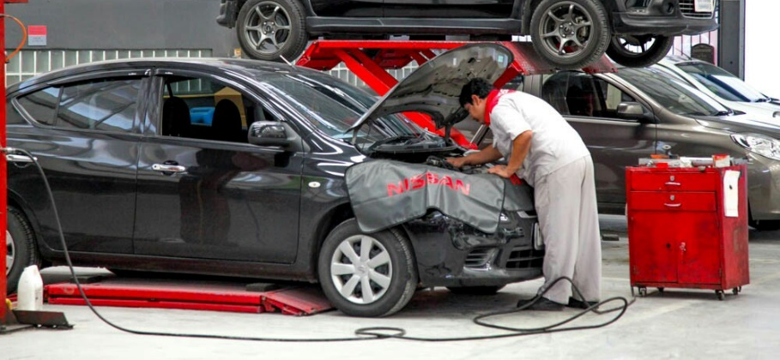
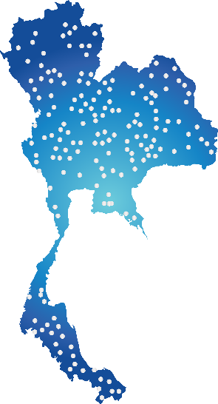


Overview of Business
Krungthai Car Rent and Lease Public Company Limited operates the rented car as operating lease with the agreement of not more than 5 years and short term rent of not more than 1 year. In addition the Company also sell the expired leasing car via distribution channels which are subsidiary companies that bring the profit of selling expired leasing car as well.
The rented cars are mainly be Japanese brand which has high turnover and can be classified as small car, medium car, big car, van and pickup which are Toyota, Honda, Isuzu, Nissan and etc. Moreover, the Company also provides European rented car to serve all customer need and to create value added for our service. The company provides first class insurance for all cars and the Company responsible for the expense related to the vehicle i.e. expense for registration and vehicle tax, inspection expense, maintenance expense including 24 hour-call center to support the customer in case of emergency and car replacement in case of accident.
The Company established service center at Head Office located on Rama III road and Asoke branch including the contract service centers more than 800 centers in order to ensure the good care of customers all times and also protected against risks that may have happened to the assets of the company. In addition, the service center on Rama III also open for any individual who requires the maintenance service for Nissan cars.
Presently, the other subsidiary company, Krungthai Automobile Co., Ltd., which the Company holds 100% of total shares operates the business of buying, selling and exchange the variety of used cars in any brands and types. The Company business has been integrated because the Company able to sell the expired leasing car through this channel directly to the customer and gain higher price together with less selling administration cost. Moreover the subsidiary company can also make a return to the Group from selling of used cars that purchased from others. As a result, the company gains higher car sales and higher revenue.
04

Slide 7


Vision & Corporate Policy
EXCELLENCE SERVICE
Vision & Corporate Policy
“The Leading Car Rental company focusing on distinguished services, underlining the business growth in sustainability way, emphasizing on the business partners collaboration and customer-value creation philosophy, developing staff skills to progress and professional-liked while nourishing them the morality, community, social and environment responsibilities under the good corporate governance practices.”
Professionalism: proficiency and responsibility to ensure the excellence of quality
Partnership: service and relationship which bring about customers' top satisfaction
Dynamism: determination, dedication, and continual amelioration to secure the standpoint of car rental business on a sustainable basis
05

Slide 8
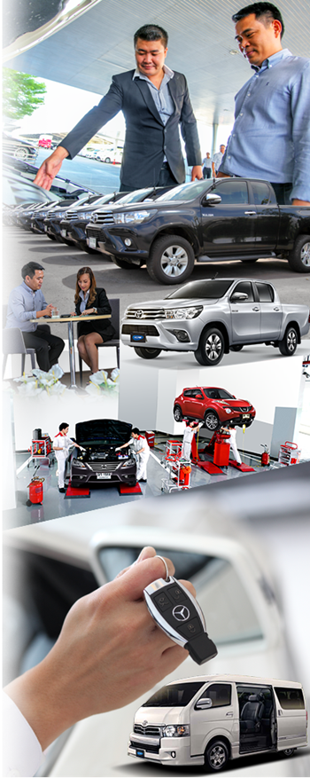
Strategy and Competitiveness
The company is known as a competitive car rent business as the company has been providing car rental service for a considerable period of time. It is known in a broadened scale that the company is a big player in the business types of operating lease and short-term lease.
The management has a good relationship with customers. Thanks to a long history of the operations of business, the company enjoys a large base of customers, thus increasing the opportunity of service provision and risk diversification by depending not on one group of customers on an exceedingly large proportion.
The company offers a full-scale service with premium quality by focusing on customers’ satisfaction on every level of service. The company purchases the right vehicles according to each customer’s requirements. As an added value to the service, the company also purchases first-class car insurance policies from some of the reputable insurance companies in the market and takes responsibility in the maintenance cost, e.g. reparation and annual registration renewal. In addition, the company also provides a full-scale after-sales service e.g. repair service with replacement cars, all by more than 800 branches of check-up and repair bays across the country. The company also offers value-added services and other activities to inform customers and keep them educated on benefits from the rental service, e.g. safe driving activity and study visits to car manufacturers.
As the company currently has more than 8,300 cars for lease. It enjoys the benefits of the economy of scale, with some of the advantages being the considerably high power of bargaining and reduced cost of procurement of cars, spare parts, and interest rates. In addition, the company also enjoys a reduction of a part of operational costs, one of which is the cost of manpower per car.
The company operates its own service centre with highly skilled mechanics and technicians to render service to the customers. The company also estimates the cost of maintenance in a more efficient way, which can reduce the company’s cost of operations.
The company has increased the earmarked marketing budget to focus more on advertisements in various media, including organising of promotional events on the company’s web site in a bid to boost and publicise the company’s image for the wider audience.
The company encourages the learning of knowledge and information on the benefits of car operating lease by providing training session for the employees on a regular basis, for they will successfully educate potential customers about cost management, tax and operational benefits that customers are entitled to, e.g. maintenance control, budget control, and so on.
06

Slide 9
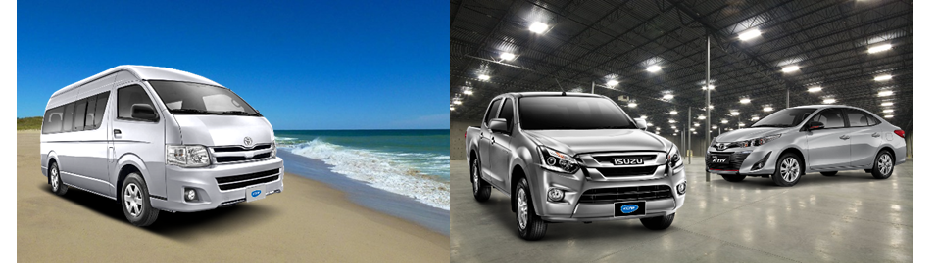
Nature of Business
Structure of Income
Note: ^{1/} Income from other sources e.g. service centres, received interests, termination fee, and sales promotion.
Nature of services
The Company operates and provides services for operating lease with a lease term of from one year to five years to the corporate customers and also provides short-term rental car services (from daily to monthly basis) for corporate and individual customers. It also provides one- stop service through more than 8,300 standard cars in various models and sizes.
The customer's objective to exploit operating lease is different from purchase, hire purchase and financial lease. For operating lease, customers would like to utilize that asset temporarily without ownership so that they could cut back maintenance expenses and other involved expenses such as taxes, car insurance and etc. Also, they can reduce financial obligation because they neither need to pay a large amount of money to acquire a vehicle nor need to procure loan and guarantees. Moreover, as a corporate identity they can get corporate tax benefit on operating lease. As a result, operating lease becomes more popular among customers. The Company believes that operating lease business is still in the growth state and thus, only operating lease and short-term rental are underlined.
Source of Income | By | % Shares of the Company | 2015 |  | 2016 |  | 2017
 |  |  | Million Bath | % | Million Bath | % | Million Bath | %
1. Rental Cars | Company |  | 1,138.01 | 58.49 | 1,132.80 | 56.56 | 1,146.92 | 54.81
2. Sale of Used Cars | Company |  | 517.59 | 26.6 | 628.66 | 31.39 | 694.56 | 33.20
3. Sale of Used Cars | subsidiary | 100 | 229.25 | 11.78 | 178.85 | 8.93 | 191.70 | 9.16
4. Other sources^{1/} | Company /Subsidiary |  | 60.94 | 3.13 | 62.65 | 3.12 | 59.21 | 2.83
Total |  |  | 1,945.79 | 100 | 2,002.96 | 100 | 2,092.39 | 100.00
07

Slide 10
Nature of services
1. Operating Lease
The operating lease covers a lease term from one year to five years. The target groups include medium and large corporations, multinational corporations, government agencies and state enterprises having demand for vehicle services together with comprehensive supplementary services to reduce their unnecessary expenses relating to vehicle operation and management. The customers can choose the brand name and models of the cars including options and accessories as required. The Company will be responsible for car checking and making a first class insurance which the Company will be the beneficiaries. Moreover, the customers have many choices for after-sales service such as maintenance and repair program and temporary replacement cars. Ownership over the cars still belongs to the Company after the lease agreement becomes expired. The Company has a policy to collect a car rental deposit at the average rate about three months of the rental fee. Nonetheless, the deposit can be waived, depending on the financial status and creditability of the customers. If the customers default on leasing fee for more than 3 months consecutive, the Company will confiscate the rented car and call for all payments as indicated in the agreement.
2. Short Term Rental
The Company provides a short-term rental service on a daily, weekly and monthly basis, focusing on the existing operating lease customers who additionally require a short-term rental and other individual and corporate customers. The customers are able to choose from various options classified by size of engines and variety of models. The Company will collect the full rental fee in advance plus deposit. Collection of the said deposit is subject to the qualification of the customers and the model of car to be rent. In case the customers do not want to pay the deposit, they must provide a guarantor and pay the deposit on their behalf and if they default on rental payment for more than three days consecutive, the Company will confiscate the rented car and call for all payments as indicated in the agreement.
In addition to providing such services, the company recognizes the value of the customer. The service is another factor which is of particular importance. This is to increase the value of providing comprehensive services and to provide our customers with the best service as following:
1.) Customer Service
Customer Service Officer provides counseling services and gets feedback from the customers to find the appropriate solution in accordance with the requirements of the customer under cost effectiveness including knowledge providing on financial and tax management that customers can be obtained from Operating Lease. Moreover, the officers also establish the customer satisfaction surveys to improve the service to maximize the customer satisfaction.
2.) 24 hour-Call Center
The company set up a team that will coordinate and make recommendations together with emergency technicians and vehicle movement which is ready to daily assist at the scene with a car towing service for Bangkok and metropolitan area.
3.) Service for Maintenance and Inspection Intervals
The Company provides the service for maintenance and inspects the car over the lease with the Preventive Maintenance Program that able to service the customer quickly and accurately so that the customer can use the car with the most effective and safety. The company has a policy to inspect the car prior to customer delivery and after the repair of the car’s body. The Company also establishes the policy on maintenance and inspection of the car according to the manufacturer standard. The service centers for maintenance and inspection intervals spreads around the country i.e. Headquarters on Rama 3 Road, Asoke branch and other spot centers including the contract center with more than 800 locations.
08

Slide 11
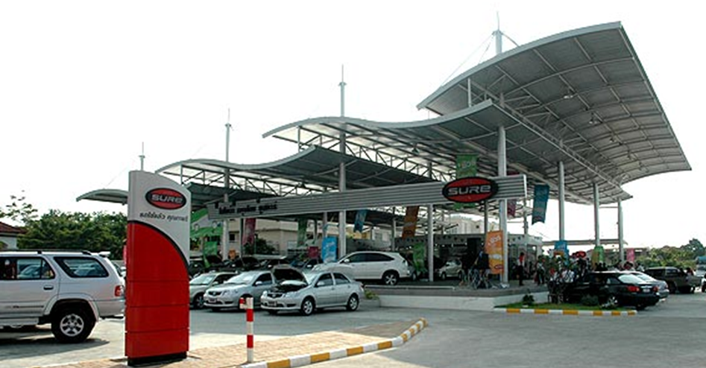
4.) Service of third party insurance and car insurance
The company will undertake to provide third party insurance and deliver to the customer. The Company also provides the first class car insurance with a reputation insurance company for every car.
5.) Service for Car Replacement in case of accident or loss
In case of accident and loss, the Company provides car replacement to the customer under the condition specified in leasing agreement.
2.1.2 Purchase and Sale of Used Cars
In addition to car rental both of Operating Lease and short-term contracts which are the main business of the Company as above mentioned. The Company conducts its business support services for car leasing is the purchase and sale of used cars operated by a subsidiary company, KrungThai Automobile Co., Ltd. ("Krungthai Automobile") under the commercial name "Toyota's Krungthai Used Car" which has 4 branches on the Karnchanapisek Road, Khet Bangkhae, Bangkok, the second branch located on Srinakarindra Road, Khet Pravet, Bangkok ,the third branch located on Phahon Yothin Road, Khet Bangkhen Bangkok.,and the fourth branch located on Kanchanaphisek-Baromarachachonani Road.
09

Slide 12
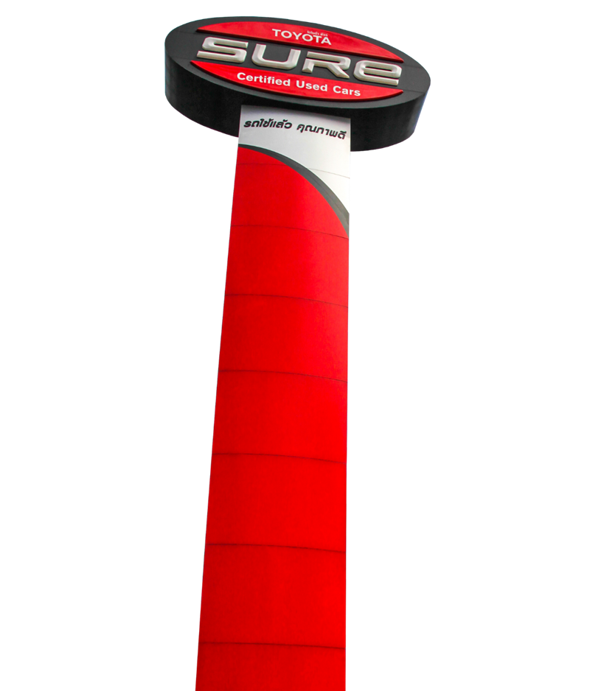
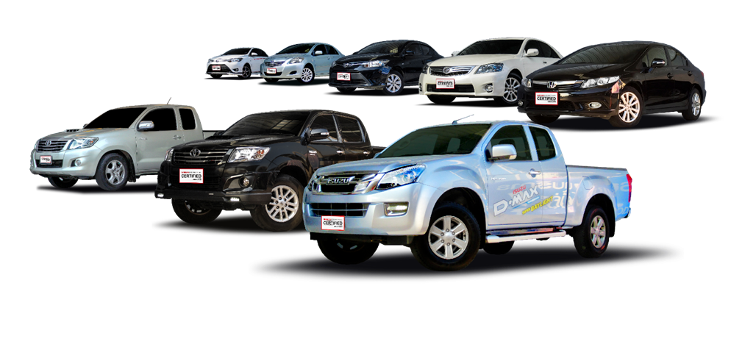
Krungthai Automobile has joined with Toyota Motor Thailand Co., Ltd ("Toyota Thailand"), a manufacturer and distributor of Toyota in Thailand for the project of Toyota Sure Program, which sold Toyata used cars under the framework and management advice and assistance activities from Toyota Thailand such as the warranty for used cars sold by Toyota Thailand for 1 year or in a distance of 20,000 kilometers, the supply of inventory and sales channels, assisting in the marketing budget and applied for the support systems and technologies. The project was successful in many countries around the world such as USA, Japan and etc. In addition to the car in the Toyota Sure, Krungthai Automobile also able to sell or buy used cars every brand not limited to only Toyota brand.
Market Situation and Competitiveness
Operating Lease
Now, the car leasing companies in Thailand can be divided into 2 types of service. The first one is Financial Lease and Hire Purchase. The second one is the company which mainly is Operating Lease including one- stop service with rental cars.
The Financial Lease and Hire Purchase operation is the loan to customers who sign the lease agreement and pay the installment to the lessor. The customers can occupy and use the assets and there is the purchase option or in the agreement identified that the ownership is transferred to the customers when the customers has paid all the installments required by agreement. These operators are mostly financial institutions, subsidiaries of the manufacturers and distributors and other leasing companies. These operators are not the direct competitors even the business operation is similar but the target customers are different as well as the different market strategy especially for pricing and interest strategy.
10

Slide 13
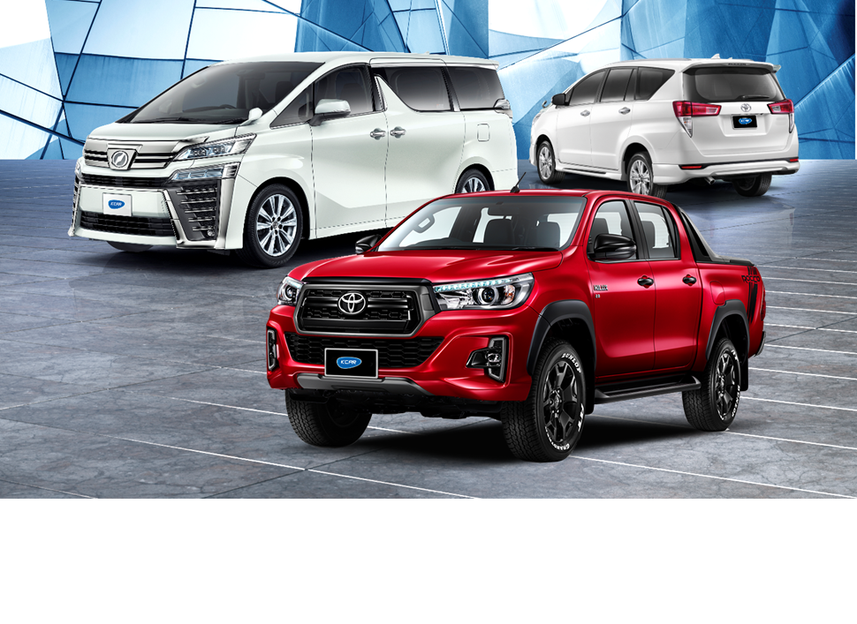
The Operating Lease is the rental agreement which allow customer to use the assets as well as the agreement can be cancellable. The lessee will be responsible for maintenance cost and at the end of the lease, the lessor can re-lease these assets with others. The market strategy will be focused on the service quality which the Company operates this operating lease as the main business. Currently there are many operation lease companies and mainly they focus on the daily or weekly rental however these companies also are considered not our main competitors.
Competitiveness in Car Rental Business over the past year
In the past year of 2017, the car rental market continued to witness a considerable growth as seen from rising demand of cars from both Thai clients and foreign corporate clients expanding their businesses into Thailand who really see the advantage of car lease in terms of cost control, budget control, and the benefit of reducing operational workload and costs, as well as the benefit from government subsidisation in effort to stimulate spending in the economic sphere.
In the meantime, still clearly saw a fierce competition in the car rental business, notably among the larger-sized car rental firms which are known to have had tax benefits from the government and to focus on expanding their portfolios to gain bigger portions of the market share. The company realises the necessity in giving precedence to competition in pricing in a larger extent. The move rendered more business opportunities in acquiring a larger number of auctioned car rental contracts from the free market. The market direction that points toward lower rental fees that are not reflecting the real costs will still be the mainstream idea while secondhand car market forecast is inclined to the positive side.
11

Slide 14
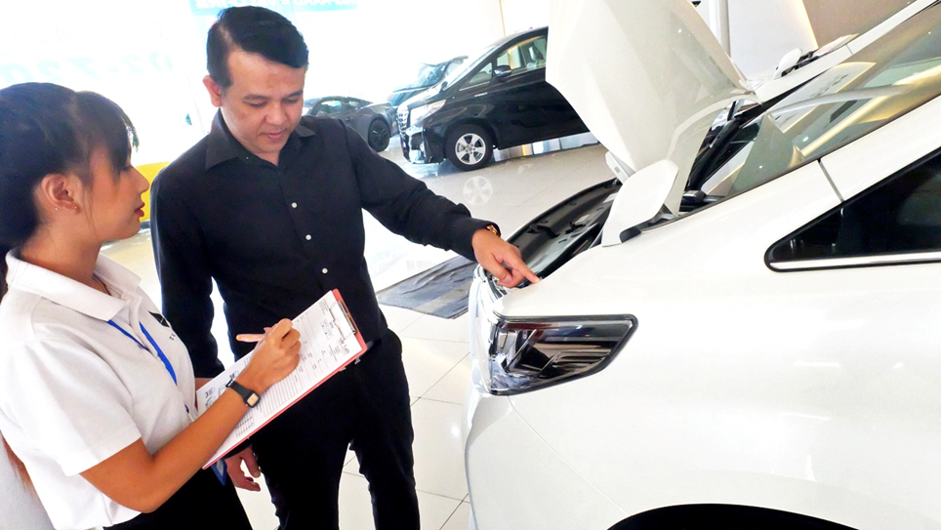
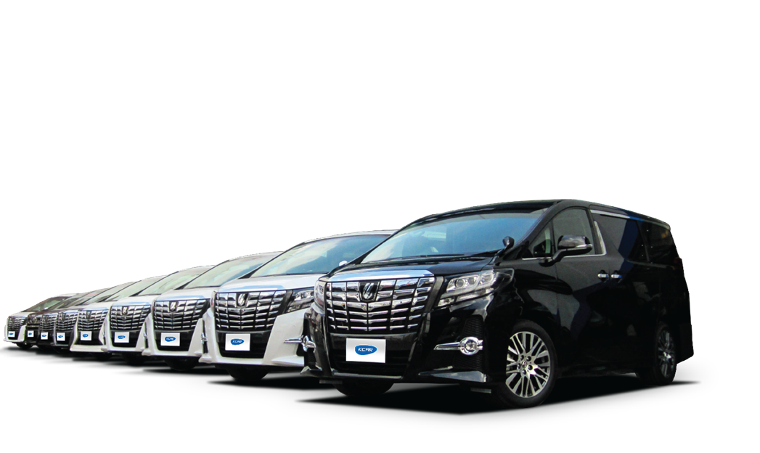
The company still adheres to the determination to expand our portfolio of rental cars, improve the efficiency of cost management, and proritise better the rendering of particular services needed by the clients.
The used car market in 2017, We have found that the government’s “First Car” scheme that ended last year did not adversely affect the sales of secondhand cars. The company did a calculation and spread the proportions of to-sell cars proportionately between 2016 and 2018. The number of cars seen rolling back to the market did not trigger a situation of oversupply. There has been a forecast indicating that the secondhand car market would turn into a positive direction following the ameliorating economic situation thanks to loan granting and facilitations from financial institutions. After the secondhand car market situation floated to the surface, the prices were seen to improve last year.
12

Slide 15
Risk Factor
Interest rate risk
In the operating lease business, there is the fixed interest rate throughout the life of the agreement making the Company has the fixed income from rental car. While cost of its operation comes from the interest loan with 2 types; fixed rate and floating rate subject to the market rate of interest. Therefore a risk of the spread of the income received and interest expense will impact directly on the cost and profit of the Company.
Therefore the Company has the policy to reduce this risk by finding the cost of fund which complies with the nature of business. The Company has managed risk with 2 aspects; duration and interest rate. In term of duration management, the Company will set the loan period matching with the lease period. Regarding the interest rate risk, the Company will try to obtain loans at a fixed cost to match with the car rental nature by keeping the difference between interest rate and rental income at the levels of profitability and consistence.
The proportion of fixed rate and floating rate is as follows:
Salvage Value Management Risks
The Company operates operating lease business with the period from 1 year to 5 years. After the expiration of agreement, the company may consider to keep the car for short rental with period from 1 year to 2 years. In case of ineffective management, the company may encounter a risk of purchasing too many cars. However, the company’s subsidiary named Krungthai Automobile Co., Ltd. centralises the sales of used cars under the brand “Toyota Sure” from Toyota Motors (Thailand) Co., Ltd. Thus, the trust from the customers on used cars helps to secure confidence from potential customers, hence the increased opportunity of selling cars.
The company is focusing on maximising the capability of selling lease-expired cars. Therefore, the management has deployed the policy of asset management as follow:
Type of Interest | 31 December 2015 |  | 31 December 2016 |  | 31 December 2017
 | Million Baht | % | Million Baht | % | Million Baht | Million Baht
- Fixed | 1,346.98 | 75.85 | 1,845.38 | 73.14 | 2,286.39 | 80.63
- Floated | 429.53 | 24.18 | 677.55 | 26.86 | 549.13 | 19.37
Total | 1,776.51 | 100 | 2,522.93 | 100 | 2,835.52 | 100
13

Slide 16
1.) Establish its own service centres and the network of over 800 establishments with expertise in vehicle maintenance. The company’s service centre will provide useful advice and ensure that customers are able to keep the leased cars timely and in accordance to the maintenance programme in order to be entitled to as good quality as market requirement and in order to facilitate the sales of used cars at a higher price.
2.) Conduct its own selling activity by negotiate sales directly with buyers through KrungThai Automobile Co., Ltd., a subsidiary of the company. This policy enables the company to manage the existing cars with more efficiency. In 2017 and 2016 the company had sold away a total of 1,655 lease-expired cars, and 1,460 lease-expired cars, respectively. The profit of lease-expired car sales in 2017 totalled 271.74 million baht, and in 2016 totalling 245.06 million baht, respectively.
3.3 Risks in Financial Liquidity
The Company has source of fund from shareholders and borrowing with a proportion as follows:
Taking into consideration the source of funds, the company may be considered at risk in financial liquidity as it is restricted by loan payments caused by certain loan contracts made by the company and financial institutions. However, taking into consideration the structure of debt from the company’s financial report, the company’s source of funds is divided into two categories, 1) 1,390.35 million of short-term capital, and 2) 3,459.09 million baht of long-term capital (comprising 1,445.18 million baht of long-term debt and 2,013.91 million baht of shareholders’ part) or to put it in simple terms, the company’s debt structure is 29:71 the ratio of short-term against long-term capital. Taking into consideration the payable debt within one year of 1,390.35 million baht in fixed short-term securities, financial institution-fed long-term debt, and debt from purchase contracts, the company is confident in its strict management of cash flow by rushing to liquidate its spool of used cars in the waiting-to-sell list in return for sufficient cash flow for normal business operation.
 | 31 December
 | 2015 |  | 2016 |  | 2017
 | Million Baht | % | Million Baht | % | Million Baht | %
Shareholders’ equity | 1,786.65 | 50.14 | 1,982.22 | 44 | 2,013.91 | 41.53
Loans from hire purchase
- Current portion | 424.47 | 11.91 | 329.78 | 7.32 | 231.17 | 4.77
- Over 1 years | 572.09 | 16.06 | 348.53 | 7.74 | 114.91 | 2.37
Loans from financial institutions and
Bill of Exchange/Debentures
- Short-term loans | 278.16 | 7.81 | 671.95 | 14.92 | 799.84 | 16.49
- Long-term loans | 124.78 | 3.5 | 276.98 | 6.15 | 359.34 | 7.41
- Total Short-term loans | 402.94 | 11.31 | 948.93 | 21.06 | 1,159.18 | 23.90
- Debentures | - | - | - | - | 549.21 | 11.33
- Total Long-term loans | 377.01 | 10.58 | 895.7 | 19.88 | 781.06 | 16.11
Total loans | 1,776.51 | 49.86 | 2,522.93 | 56 | 2,835.52 | 58.47
Total | 3,563.16 | 100 | 4,505.16 | 100 | 4,849.44 | 100.00
14

Slide 17


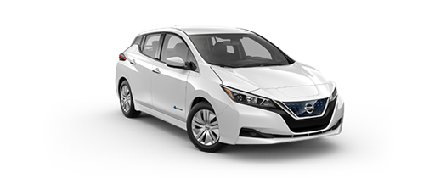
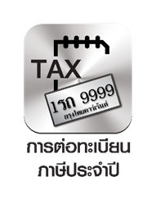

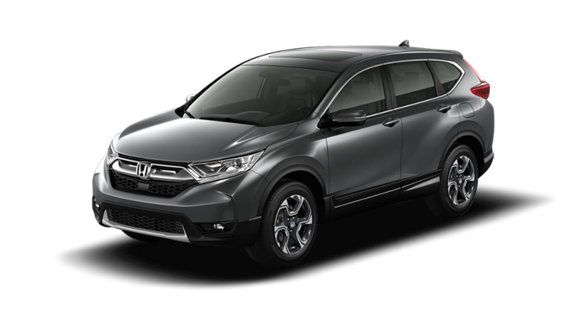


Moreover, when taking into consideration the minimum income from future rental under interminable operating lease contracts that fall in the categories of less than one year and more than one year of validity period, as of the end of 2017, they were 1,020.38 million baht and 1,673.37 million baht respectively, while the current portion of liabilities of 1,390.35 million baht is due to be paid back within one year; and of the long-term liabilities of 1,445.28 million baht.
In 2018, the Company will have approximately 1,400 cars exceeding the leasability period, which is considered sufficient to maintain the liquidity of the Company. Apart from the measures described, the Company also follows other policies to ensure better control of the collection of rental income, and more effective marketing of the sales of used cars.
Operating risk
The Company is likely to not be able to collect the rent and call back the cars if the selecting customers can not be done carefully, including the lack of effective collection follow up and lack of proper internal control system.
In order to reduce the risk, the Company measures the customers selected carefully by consideration in the ability of customers to pay the rent from the operation results and financial positions from the past to the present as well as the reliability of the customers. In addition, the Company has the policy to protect risk from customers individually. For the short-term lease agreement, customers must provide a guarantor or pay the high rental deposit for full advance payment according to the lease period which can protect the risk from its operation in a certain level. For the operation lease agreement, the Company has policy to collect the deposit average 3 months of rental fee. Although the Company still has some risk on uncollectible money after deducting the deposit, the Company’s experience and customer selection process including the effectiveness on debt collection equipped with proper internal control, the Company is tracing these accounts on time and the adequate provide the allowance for doubtful accounts.
15

Slide 18
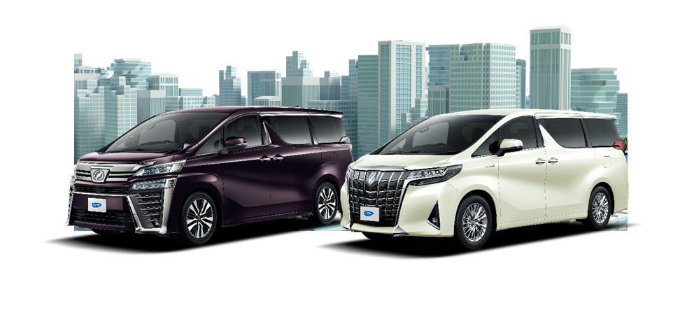
Marketing risk and Competition
Due to the rental cars business has a small legal restriction combined with low capital investment to start a business, result in many entrepreneurs in the car rental market which creates high competition of this business as well. The main competition is the pricing which may affect sales and profits of the Company.
In order to reduce this risk, the Company, as the big player, has the clear policy focusing on the Premium Quality and One Stop Service. The Company has implemented a modern and efficient computer system for its operation in order to monitor the service closely and thoroughly. As the big player would result in Economy of Scale leading to save costs and compete in pricing as well. However, the Company does not focus only on pricing strategy.
As well as, the Company has selected the clear target group in comply with the long-term leasing policy. The main customers are medium and large corporation including government agencies and state enterprises, etc. These target groups prefer the long-term car leasing with good after-sales service rather than focusing on price only.
Economic Risks
In 2018, the company anticipates better prices in the used car market following the increase of excise tax for new cars. However, loan grants from financial institutions is still a factor for negative impact, which lead to probable drop of used car prices.
Risks to the Society and the Community
The Company recognizes the principle of working by joining together the main work with the care for the society and the community, with a focus on the potential impact of the rental car business operation. The Company established a project to promote road safety to give advice to car users which are the Company's customers. The project aims at promoting road safety among motorists, with consideration to pedestrians, including items on the roads.
Risks to the Environment
Although the Company is not directly involved in the utilization of environmental resources, it also takes into account the environmental impact that may emerge, indirectly, from the waste generated by car maintenance. The Company has written up a protocol to take care of the waste management in the company to help reduce the pollution made by the Company.
16

Slide 19
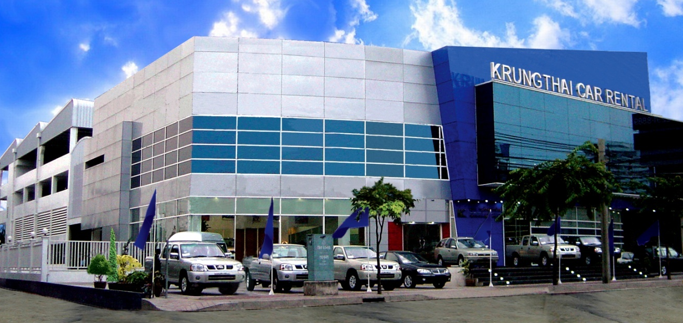
General Information
Company Name :Krungthai Car Rent and Lease Public Company Limited
Stock Code :KCAR
Nature of Business :Operating lease services and short-term car rental
Registered Capital :Paid-up capital of 250,000,000 shares, with a par value of Baht 1.00 per share
Head Office :455/1 Rama 3 Road, Bangkhlo, Bang Kho Laem Bangkok 10120
Asoke Branch :288/9 Asok-Din Daeng Road, Bangkapi, Huai Khwang, Bangkok Registration No. :Bor. Mor. Jor. 0107547000761
Telephone :66 (0) 2291-8888
Fax :66 (0) 2291-4488
Website :www.krungthai.co.th
Registrar :Thailand Securities Depository Company Limited.
93 Ratchadaphisek Road Din Daeng , Bangkok Thailand.
Tel: 66 (0) 2009-9000 Fax: 66 (0) 2009-9991
Auditor : Miss Sulalit Ardsawang,
Certified Public Accountant No. 7517
Audit Firm Name :Dharmniti Auditing Company Limited
Audit Firm Location :178 Soi Permsap (Prachachuen 20), Prachachuen Rd.,
Bangsue, Bangkok 10800
Tel: 66 (0) 2596-0500 Fax: 66 (0) 2596-0539
17

Slide 20
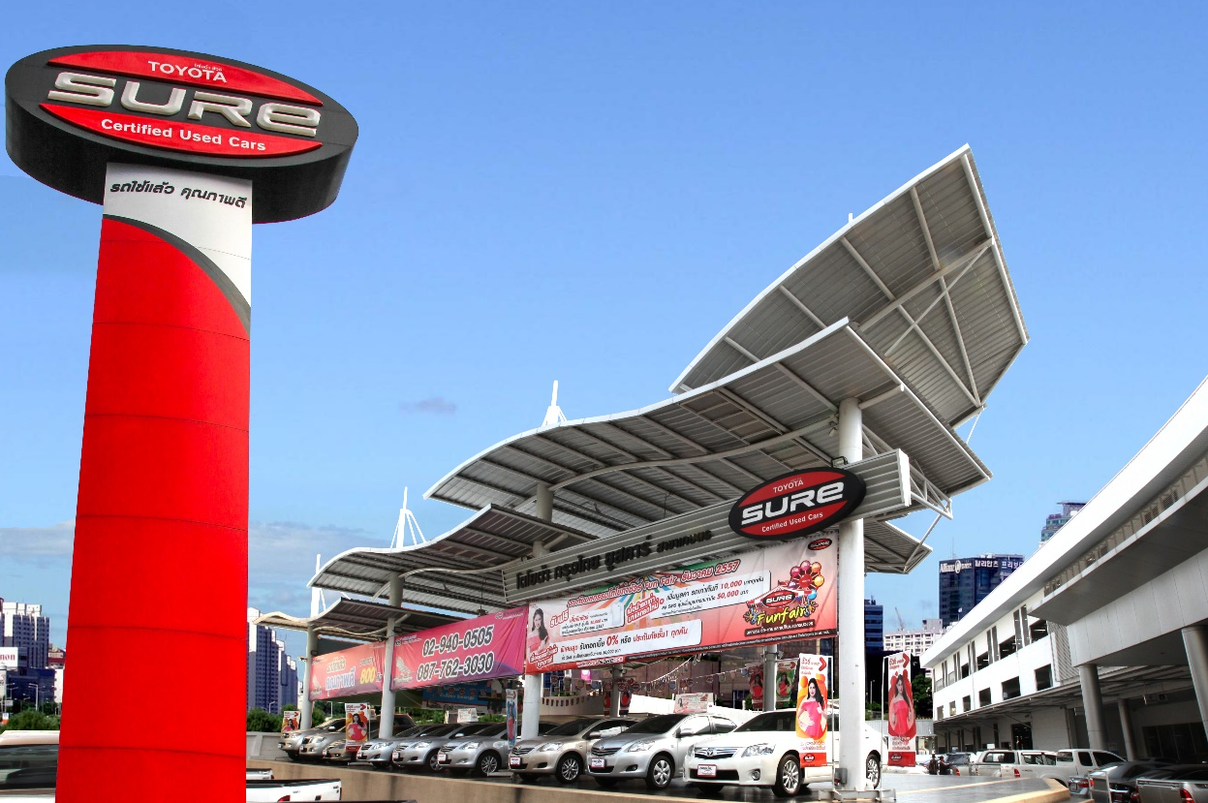
Subsidiary Name :Krungthai Automobile Co., Ltd.
Shareholding Status : 100 percent of paid-up registered capital
Nature of Business :Purchase, sell, exchange, repair and distribution of new & used cars and equipment
Registered Capital :Paid-up capital of 400,000 shares, with a par value of Baht 100.00 per share
Head Office :1625 Bangphai, Bangkhae, Bangkok
Srinakarindra Branch : 41/2 Srinakarindra Road, Pravet, Bangkok
Kaset Branch : 2368 Phahon Yothin Road, Bangkhen, Bangkok
Kanchanaphisek
-Baromarachachonani Branch : 64 Kanchanaphisek Road,Banglamad,Talingchan, Bangkok
Telephone :66 (0) 2455-4455
Fax :66 (0) 2455-4441
Website : www.surekrungthai.com
Auditor :Mrs. Rungthip Changsrisuk
Certified Public Accountant No. 11930
Audit Firm Name :Dharmniti Auditing Company Limited
Audit Firm Location :178 Soi Permsap (Prachachuen 20), Prachachuen Rd.,
Bangsue, Bangkok 10800
Tel: 66 (0) 2596-0500 Fax: 66 (0) 2596-0539
18

Slide 21
Shareholder Structure
List of the top 10 major shareholders as of the close of Share Register Book on 22 August 2017
Rank | Names | Number of Shares Held | %
1 | The Chantarasereekul Family^{1/} | 183,528,300 | 73.41
2 | Aberdeen Small Cap Fund | 14,915,900 | 5.97
3 | The Khunsongkiat Family^{/2} | 4,631,600 | 1.85
4 | Mr. Sunchai Udomrattanavanich | 1,650,000 | 0.66
5 | One-Ultra Income Fund | 1,454,300 | 0.58
6 | Mr. Suthee Ariyachartphadungkij | 1,380,000 | 0.55
7 | The Kamthornthip Family^{/3} | 1,296,500 | 0.52
8 | The Lurchuwong Family^{/4} | 1,292,800 | 0.52
9 | Bangkokinsurance by Aberdeen | 1,080,600 | 0.43
10 | The Rungthanapirom Family^{/5} | 940,000 | 0.38
 | Others | 37,830,000 | 15.13
 | Total | 250,000,000 | 100.00
^{1/} The Chantarasereekul Family includes
Mr. Paitoon Chantarasereekul holds 10,000,000 shares represent 4.00%
Mrs. Wipaporn Chantarasereekul holds 40,512,400 shares represent 16.20%
Mr. Pithep Chantarasereekul holds 34,000,000 shares represent 13.60%
Mr. Pichit Chantarasereekul holds 34,000,000 shares represent 13.60%
Mr. Pisit Chantarasereekul holds 25,000,000 shares represent 10.00%
Ms. Pimontra Chantarasereekul holds 20,221,000 shares represent 8.09%
Ms. Pimonpan Chantarasereekul holds 19,794,900 shares represent 7.92%
^{2/} The Khunsongkiat Family includes
Dr. Prajuab Khunsongkiat holds 595,500 shares represent 0.24%
Ms. Piyada Khunsongkiat holds 4,036,100 shares represent 1.61%
^{3/} The Kamthornthip Family includes
Mr. Tadchai Kamthornthip holds 304,400 shares represent 0.12%
Mrs. Thippawan Kamthornthip holds 575,000 shares represent 0.23%
Mr. Verakij Kamthornthip holds 417,100 shares represent 0.17%
^{4/} The Lurchuwong Family includes
Dr. Jomchai Lurchuwong holds 1,252,800 shares represent 0.50%
Mrs. nuanpen Lurchuwong holds 40,000 shares represent 0.02%
^{5/} The Rungthanapirom Family includes
Mr. Thanapat Rungthanapirom holds 650,000 shares represent 0.26%
Mr. Tanawat Rungthanapirom holds 290,000 shares represent 0.12%
19

Slide 22
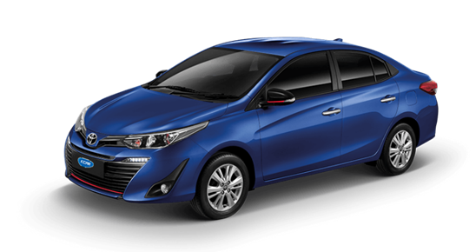
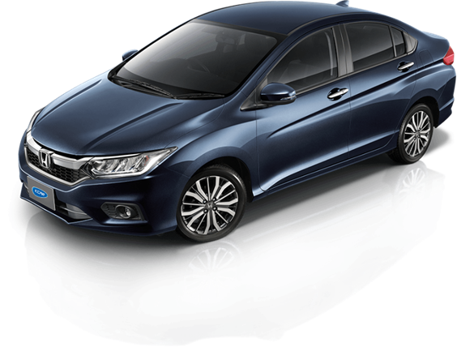
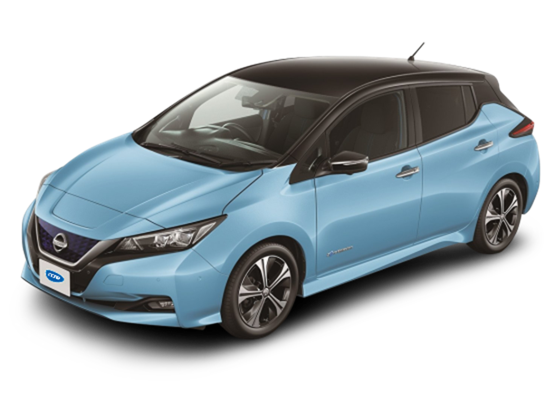
Dividend Payment Policy
The company is bound to pay no less than 50% of net profit after deducting the corporate tax and legal reserve in each year. The dividend payment shall depend on the consideration of financial position and operation result, liquidity, future expansion project and etc. However, the Company concerns on the maximize benefits to shareholders. The dividend payments shall be approved by the resolution from the shareholders or the Board of Directors.
20

Slide 23
Management Structure
Management Structure as at 31 December 2017
The Chairman of the Board
of Directors
Mr. Pithep Chantarasereekul
Directors
Mr. Pithep Chantarasereekul
Mr. Pichit Chantarasereekul
Mr Karoon Laoharajatanand
Mr. Chaiwat Atsawintarangkun
Mrs. Supaporn Jittmittraparp
Assoc Prof Dr Pasu Decharin
Managing Director
Mr. Pichit Chantarasereekul
Internal Auditor
Supitcha Khajornchaikul
Secretary and Legal Manager
Noppol Sakthong
Senior Assistant Managing Director - Business Support
Sakditouch Chantarasereekul
Vice President – Marketing
-
Service Director
Sirima Cha-emkun
Senior Marketing Manager
Jittiya Luangjamekorn
Finance and Accounting Manager
Pornpan Sattawatkul
Marketing Manager
Former Customers
Patthanan Jarungklin
Relationship Manager
Sunthareeya Wangchai
Service Center Manager
Kanpavit Jaikwang
Administration Department Manager
-
Marketing Manager
New Customers
Veeradech Lorjitamnuay
Short- Term Marketing and
Replacement Car Manager
Chanthip Saeow
Service Center Manager Asoke Branch
-
Short- Term Marketing Manager
Asoke Branch
Natticha Naka
Replacement Car Manager
Jengmanee Kutanant
21

Slide 24
The Board of Directors
(1.1) The Board of Directors
As at 31 December 2017, the Board of Directors consists of 6 directors (all directors have been trained with the Director Accreditation Program) as followings:
* Mr Noppol Sakthong as the Company secretary
Authorized Directors
Authorized directors consist of Mr. Pithep Chantarasereekul and Mr. Pichit Chantarasereekul authorized directors may sign jointly and affixed with company seal to bind the Company.
1.2) The Board of Directors of the Subsidiary Company
The Board of Directors of Krungthai Automobile Company Limited consists of 3 directors as followings
Authorised Directors of the Subsidiary Company
Authorised directors of the subsidiary company consist of Mr Pithep Chantarasereekul and Mr Pichit Chantarasereekul. Any one of the three authorised directors may sign, with company seal affixed, to act on behalf of the subsidiary company.
Rank | Name |  | Position
1 | Mr. Pithep | Chantarasereekul | The Chairman of the Board
2 | Mr. Pichit | Chantarasereekul | Director
3 | Mr Karoon | Laoharatanun | Director
4 | Mr. Chaiwat | Atsawintarangkun | Independent Director and the Chairman of the Audit Committee
5 | Mrs. Supaporn | Jittmittraparp | Independent Director and Member of Audit Committee
6 | Assoc Prof Dr Pasu | Decharin | Independent Director and Member of Audit Committee
 | Name |  | Position
1 | Mr. Pithep | Chantarasereekul | Director
2 | Mr. Pichit | Chantarasereekul | Director
3 | Mr. Pisit | Chantarasereekul | Director
22

Slide 25
In 2017, a number of members of the committee participated in a training seminar in an effort to ameliorate their operational efficiency, names and formations are as follow:
Duty and Authority of the Board of Directors
The Board of Directors has authority and manages the Company in accordance with the law, objectives and articles of the Company as well as legitimate resolution of Shareholders’ Meeting.
The Board of Directors has a responsibility for setting goals, guidance, policies and budgeting of the Company, supervise the Executive Board of Directors in accordance with the assigned policies with the exception of such matters which the Board of Directors requires the approval from the resolution passed of the Shareholders’ Meeting prior to the execution namely matters required by laws such as increase and/or decrease of share capital, the issuance of Company’s debenture, the purchase or transfer of the Company’s business or the acquisition or merge with others, the amendment of the Company’s memorandum of association and regulations as well as the remuneration of Directors and so on.
The Board of Directors may appoint a number of directors to be the Executive Board of Directors who have authority to supervise the business of the Company as the Board assigned. And one of the directors is appointed to be Chairman of Executive Board of Directors.
The Board of Directors has directed the effectiveness of Company's internal controls and internal auditing by providing an internal audit department to monitor, carry out and coordinate with the audit committee.
The directors shall receive the remuneration in the form of reward, meeting fee, gratuity, bonus or other form benefits under the articles of association or as determined by shareholders’ meeting in either fixed sum or under certain criteria and such determination may be made from time to time or may take effect until otherwise determined and shall receive allowance or welfare benefits under Company’s regulations.
The Board of Directors shall not approve any transaction which their own or persons who may have conflicts of interest with the Company and / or its subsidiary.
duties of the Board of Directors also encompasses the supervision of the Company to perform in accordance with the law and regulation relevant to the securities and securities exchange for example related party transaction and the purchase and sale of assets of material substance in accordance with regulation of the Securities Exchange of Thailand or other law relevant to the Company’s business.
The Board of Directors is responsible for disclosure to shareholders and the public an accurate, complete and standardized.
 | Names | Seminar
1 | Mr. Pichit Chantarasereekul | Business expansion strategy – Thailand Management Association
 |  | Workshop: Conduct presentation like a professional – Thailand Management Association
2 | Mrs. Supaporn Jittmittraparp | Session 9 of Advanced Security Management Programme
23

Slide 26

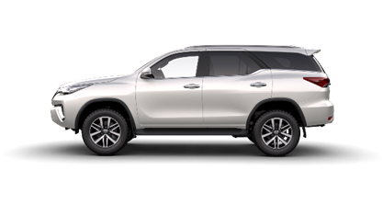
Company's Vision
“The Leading Car Rental company focusing on distinguished services, underlining the business growth in sustainability way, emphasizing on the business partners collaboration and customer-value creation philosophy, developing staff skills to progress and professional-liked while nourishing them the morality, community, social and environment responsibilities under the good corporate governance practices.”
Core Value
Professionalism: proficiency and responsibility to ensure the excellence of quality
Partnership: service and relationship which bring about customers' top satisfaction
Dynamism: determination, dedication, and continual amelioration to secure the standpoint of car rental business on a sustainable basis
2.) Audit Committee
As at 31 December 2017 , the Audit Committee consists of 3 persons as follows:
Rank | Name |  | Position
1 | Mr. Chaiwat | Atsawintarangkun | The Chairman of the Audit Committee
2 | Mrs. Supaporn | Jittmittraparp | Audit Committee member
3 | Police Lieutenant General Nopkao | Thanyasiri | Audit Committee member
Miss Supitcha Khajornchaikul acts as Audit Committee Secretary.
Working experience in reviewing financial statement of the Company
Mr. Chaiwat Atsawintarangkun The Chairman of Audit Committee
2004 – Present Director and the Chairman of Audit Committee of Krungthai Car Rent and Lease Public Company Limited Operation Leasing Business)
1997 – Present Executive Partner of Prospect Consulting Company Limited (Auditing and Finance Advisory)
2001 – 2002 Subcommittee of Financial Advisory for Forest Industry Organization
24

Slide 27
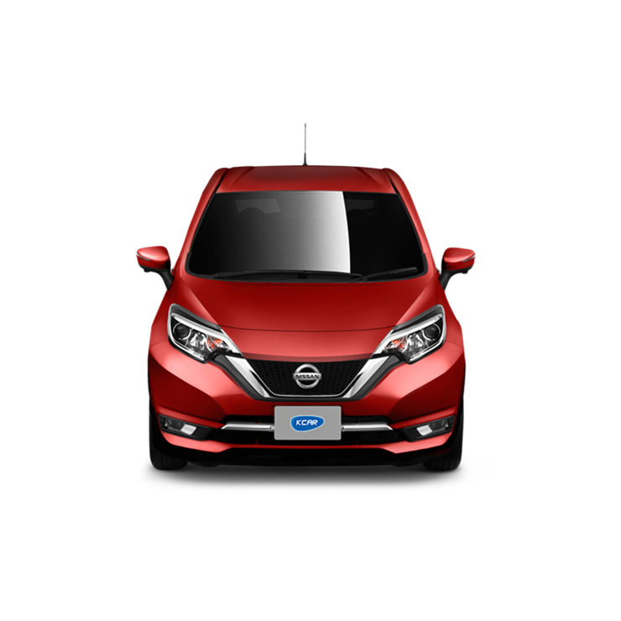
Duty and Authority of the Audit Committee
To review and ensure the company reporting accurate financial information and sufficient
To review and ensure the Company has an internal control and internal audit system, determining an internal audit unit’s independence, as well as to approve the appointment, transfer and dismissal of the chief of an internal audit unit or any other unit in charge of an internal audit.
To review and ensure the conduct of the Company in compliance with the law relevant to the securities, and securities exchange, regulations of the securities exchange of Thailand, or other law relevant to the Company’s business.
To consider the selection and propose an independent party for appointment as the external auditor of the Company, propose for the auditor’s compensation, and to participate in the meeting with external auditor without management present at least once a year.
To consider related party transactions which may have conflicting interests to be in accordance with the law and regulation of the securities exchange of Thailand to ensure that such transactions are reasonable and for the best interest of the Company.
To prepare report of the Audit Committee, and disclose the report within Company’s Annual Report such report to be affixed with the signature of the Chairman of the Audit Committee. The report should comprise the following information:
pinion on the accuracy, completeness and reliability of the Company’s financial report
pinion on the adequacy of the system of internal control of the Company
pinion on legal compliance related to the securities and securities exchange, regulation of the securities exchange, or law relevant to the Company’s business
pinion on the appropriateness of the auditors
pinion on transactions that may have conflicting interests
The number of meetings of the Audit Committee, and attendance of individual audit committee member
pinion or overall observation of the Audit Committee in performing its duties in accordance with the Audit Committee Charter
Any other reports the Committee felt the shareholders and investors in general should know within the scope of duties and responsibilities assigned by the Board of Directors.
7. To perform any other act as assigned by the Company’s Board of Directors, with the approval of the audit committee.
25

Slide 28
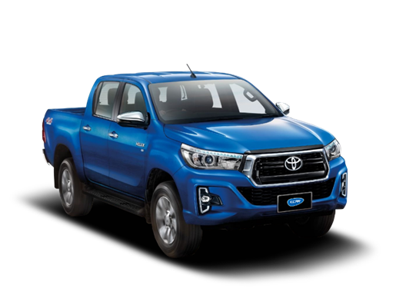
The Executive Board of Directors
As at 31 December 2017 , the Executive Board of Directors consists of 2 persons as follows:
Mr. Noppol Sakthong acts as Executive Board of Director secretary.
Duty and Authority of the Executive Board of Directors
To have authority to approve on the important operations of the company by setting the scope or the scale of the mission, objectives and policy of the company including the supervision of the overall operation, production, customer’s relationships within the scope plan and budgeting prescribed by the Board of Directors.
To consider the expansion investment including purchase and/or sale of fixed assets of the Company in order to propose to the Board of Directors
To have the authorization and represent the Company to others in any related business and beneficial to the Company
To consider in matter of funding for presenting to the Board of Directors
To approve the appointment of any consultant that is essential to the Company’s operation as assigned by the Board of Directors
To operate any transaction related to general administration of the Company
To consider and approve the operating plan of each department of the Company including the approval of the issues that beyond their power of authority
To propose for the approval of the Board of Directors on the approved operation plans that may over the budget more than 10%
Rank | Name | Position
1 | Mr. Pithep Chantarasereekul | The Chairman of the Executive Board of Director
2 | Mr. Pichit Chantarasereekul | Executive director
The Executive Board of Directors may delegate the authority to each member of executive director to process within the scope of authority under No. 3; any such executive director is responsible for this assigned work from the Executive Board of Directors.
However, the approval of the Board of Directors above does not include approval of the Executive Board of Directors or any person who may have conflicts of interest, has an interest or potential conflict of interest in any other manner with the Company and / or its subsidiary,
including items that require approval from shareholders in a transaction and the acquisition or disposition of assets of the Company and / or its subsidiary in order to comply with the requirements of the Securities Exchange of Thailand.
26

Slide 29
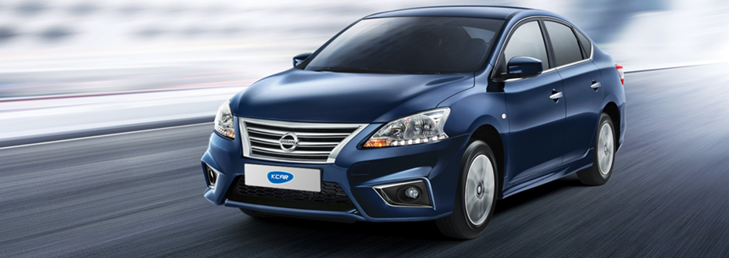
Nominating and Remunerating Committee
The members of the nominating and remunerating committee as of 31 December 2017 comprised of 3 persons, they are:
Duty of the Nominating and Remunerating Committee member:
1. Find one or more individuals who possess the needed qualities for the position of the Company's board member and submit the nomination to the board of directors in case of vacancy in one of the positions in the board.
2. Evaluate the performance of each board member and compile a report to the board.
3. Create, revise the suitable strategies and policy in remuneration for designated responsibilities, compare them to the acceptable standards in the industry, including the expected company benefits, and ensure that the policy set by the board members is enforced.
Corporate Governance Committee
The corporate governance committee as of 31 December 2017 comprised of 3 persons, they are:
Duty of the Corporate Governance Committee member:
1. Design corporate governance policy and submit to the company's board of directors.
2. Propose operational procedures in terms of corporate governance and give consultation to the board of directors in terms of corporate governance.
3. Evaluate, revise the operational procedures by taking into account the internationally-accepted norms, and propose the amendment to the board of directors for approval, to finally attain efficiency.
4. Report the assessment of each operational procedure to the board of directors according to the policy.
Rank | Name | Position
1 | Mr. Chaiwat Atsawintarangkun | Chairman of the Committee
2 | Mrs. Supaporn Chittmittrapap | Committee member
3 | Mr. Pichit Chantarasereekul | Committee member
Rank | Name | Position
1 | Mrs. Supaporn Chittmittrapap | Chairman of the Committee
2 | Assoc Prof Dr Pasu Decharin | Committee member
3 | Mr. Pithep Chantarasereekul | Committee member
27

Slide 30
Risk Management Committee
The risk management committee members as of 31 December 2017 comprised of three persons, they are
Duty of the Risk Management Committee member:
1. Constitute the policy on risk management and its limitations acceptable to the operational car lease business to propose to the committee for consideration of the overall risk management in terms of strategy, cash flow, marketing, or other risks pertaining to the business operation.
2. Designate the limitations in the efficient utilization of the company's resources to meet with the risk management policy by analysing, evaluating, and following up to each process of the risk management.
3. Revise and give consultation to the board of directors in the subject of risk management, processes, strategy, and overall risk assessment, to ensure that the policy is enforced accordingly.
4. Report and assess the outcome of risk management operation, including any updates and changes that are related to the policy, to the board of directors.
Secretary to the Company
The board of directors has appointed Mr Noppol Sakthong, who has the necessary experience and knowledge for the position of the company's secretary.
Executives
As at 31 December 2017, the Executive Committee consists of 5 persons as follow:
In 2017, a number of members of the Executives participated in a training seminar in an effort to ameliorate their operational efficiency, names and formations are as follow:
Rank | Name | Position
1 | Mr. Karoon Laoharajatanand | Chairman of the Committee
2 | Mr. Chaiwat Atsawintarangkun | Committee member
3 | Mr. Pichit Chantarasereekul | Committee member
Rank | Name | Position
1 | Mr. Pichit Chantarasereekul | Managing Director
2 | Mr. Sakditouch Chantarasereekul | Senior Assistant Managing Director of Business Support
3 | Miss Sirima Cha-emkun | Director of Service
4 | Miss Jittiya Luangjamekorn | Senior Marketing Manager
5 | Miss Pornpan Sattawatkul | Finance and Accounting Manager
 | Names | Seminar
1 | Mr. Sakditouch Chantarasereekul | Corporate Governance for Capital Market Intermediaries (CGI 18/2017)
28

Slide 31
Qualification of Executives
Executive hereby certify that they have Ethics, a talented, an experienced in the business. There are operating with honesty and care for the benefit of the Company. There are intended to operate continuously, understanding and responsibility to the public and the person listed in contact information management.
Recruitment of Directors and Executives
There is no nomination committee. The Company selects and appoints a person to be a director with the following steps.
- The Board of Directors
The Board of Directors shall comprise at least five directors and not less than one-half of the directors must have the residence in Thailand. Directors may be shareholders of the Company.
The rules and procedures in appointing the Director are as follows:
Each shareholder shall have one vote for each share.
Each shareholder may exercise all the votes he or she has under No. 1 to elect one or several persons as director or directors, but the shareholder cannot divide his or her votes between any particular person or persons.
The persons who receive the highest votes arranged in order from higher to lower in a number equal to that of the number of directors to be appointed are elected to be the directors of the Company. In the event of a tie at a lower place, which would make the number of directors greater than that required, the chairman of the meeting shall have a casting vote.
At every annual general meeting of shareholders one-third (1/3) of the directors shall retire from their office. If the number of directors is not a multiple of three, the number of directors nearest to one-third (1/3) shall vacate office.
The directors to vacate office in the first and second years following the registration of the conversion of the Company shall be drawn by lots. In subsequent years, the directors who have remained in office for the longest time shall vacate office. A vacating director may be eligible for re-election.
In addition to vacating office upon the termination, directors shall vacate office upon:
- death
- resignation
- being disqualified or being under any of the prohibitions under Public Company Limited Act, B.E.2535
- the meeting of shareholders may pass a resolution by a vote of not less than three-fourth (3/4) of the number of shareholders attending the meeting and having the rights to vote not less than one half of the number of shares held by shareholders attending the meeting and having the voting rights.
- removal by court order
7. Any director wishing to resign from office shall submit his or her resignation letter to the Company and the resignation shall be effective from the date on which the Company receives the resignation letter.
In case of a vacancy in the Board of Directors for reasons other than the termination of the term of office, the Board of Directors shall elect a person who has the qualifications and is not being under any of the prohibitions by law as the substitute director at the next meeting of the Board of Directors, unless the remaining term of office of the said director is less than two months. The substitute director shall hold office only for the remaining term of office of the director whom he or she replaces.
The Board of Directors shall elect one of the directors to be the chairman of the board. In the case where the Board of Directors deems expedient, the board may elect one or several directors to be vice-chairman. The Board of Directors may entrust one or several directors to perform any act on its behalf.
29

Slide 32
The Audit Committee/Independence Director
The Audit Committee consists of at least 3 persons and the term of office is for 3 years. The Company’s policy on recruitment the Audit Committee members/Independence directors are in compliance with the notifications of the Securities and Exchange. The qualifications are listed as follows:
1. Holding shares not more than 5 % of issued and paid-up capital of the Company, which shall be inclusive of the shares held by related persons.
2. Not being an employee, staff member or advisor who receives a regular salary from the Company or a person who has control of the Company or entity who may have a conflict of interest.
Having no blood relationship, no relationship in term of marriage or legal registration with a person of possible conflict of interest and no business relationship with the Company and entity that may have a conflict of interest.
Not having or has been in business relation with the Company, holding company, subsidiary, affiliated entity, major shareholder, or authorised person, in a manner that may obstruct the independent exercise of discretion; including not being or having been a significant shareholder or authorised person of the person with business relation with the Company, the holding company, subsidiary, affiliated entity, major shareholder, or authorised person.
Not being or has been an auditing personnel of the Company, holding company, subsidiary, affiliated entity, major shareholder, or authorised person; including not being a significant shareholder, authorised person, or partner of auditing office, with the auditor of the Company, holding company, subsidiary, affiliated entity, major shareholder, or authorised person in operation.
Not being or has been a provider of professional service which includes financial or legal consulting with service fee from the Company, holding company, subsidiary, affiliated entity, major shareholder, or authorised person of the company; and not being a significant shareholder, authorised person or partner of the provider of such professional service.
Not being a director appointed as an agent of the director of the company, major shareholder, or shareholder with relasion with the major shareholder.
Not being in operation of similar or significant competitive business to the business of the company or its subsidiary; or not being significant partner in the partnership of directorship with participation of manageability on employees, consultant with regular salary or holding more than one per cent of the total shares with voting right in other company, operating similar or competing business with the business of the company or subsidiary.
Not having other factors that could hinder expression of liberal opinion in relation with the operation of the company.
In addition, the Independence director who is a member of audit committee at least 1 must have knowledge and experience in accounting or finance that can have a reliable review the financial statement. As well as the Company considers the other qualifications such as business experience, specific expertise related to business, ethic for the best of interest of the Company.
30

Slide 33
The regulations and criteria of appointment of members of the audit committee is in compliance with regulations concerning appointment of Company directors. A member of audit committee who retires on completion of the term may be re-appointed to the position. In case of vacancy in the position of member of audit committee caused by other reasons other than completion of term, the board of directors may appoint a person with adequate expertise and qualification to fill in the vacancy in the position according to the rules set by the board of directors. The person appointed to fill in the vacancy may hold the position for the period of time equal to the remaining period of time of the recently retired member of audit committee.
Executive
The Company considered a person who has the experience and knowledge in management the related field to be the Executive Committees.
Remuneration of the Directors and Executives
1. Remuneration of the Directors
The Company provided remuneration to the Board of Directors in terms of meeting fee and monthly fee at the amount of Million Baht 1.83 as following:
2. Remuneration of the Executives
(unit: Thousand Baht)
Name/Position |  | 2016 |  | 2017
 |  | Meeting Fee | Others | Meeting Fee | Others
1. Mr. Paitoon Chantarasereekul Chairman of the Board of Directors (deceased on Sep. 2016.) |  | 104.31 | - | - | -
2. . Mr. Pithep Chantarasereekul Chairman of the Board of Directors |  | 188.45 | - | 250.99 | -
3. Mr. Pichit Chantarasereekul Managing Director |  | 188.45 | - | 207.29 | -
4. Mr. Karoon Laoharatanun Director |  | 192.52 | - | 141.18 | 161.35-
5. Mr. Chaiwat Atsawintarangkun The Chairman of the Audit |  | 136.68 | 238.92 | 150.35 | 262.81
6. Mrs. Supaporn Jittmittraparp Audit Committee member |  | 116.68 | 191.13 | 128.35 | 210.25
7. Police Lieutenant General Audit Committee member (resigned) 8. Assoc Prof Dr Pasu Decharin Audit Committee member |  | 63.71 16.30 | 191.13 16.30 | - 105.94 | - 210.25
รวม |  | 1,007.10 | 637.48 | 984.11 | 844.66
 | 2016 |  | 2017
 | Number (Person) | Amount (Million Baht) | Number (Person) | Amount (Million Baht)
ค่าตอบแทนผู้บริหาร
- Salary and remuneration | 8 | 13.70 | 7 | 12.8
- Bonus | 8 | 3.66 | 7 | 3.2
- Provident fund | 8 | 0.52 | 7 | 0.35
Total |  | 17.88 |  | 16.42
31

Slide 34
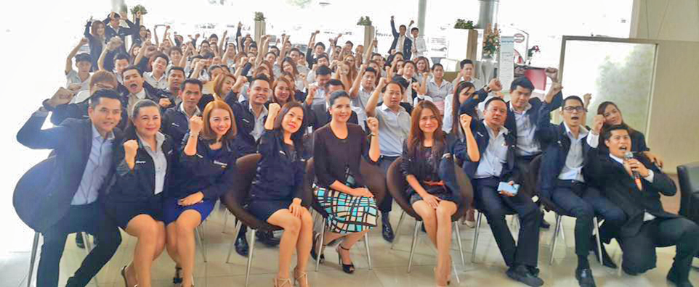
Corporate Governance
The company has a good, transparent, and socially responsible corporate governance policy which concentrates on cultivating good consciousness and ethics for executives and employees of all levels to the extent of becoming the corporate culture.
Organisation’s Long-Term Goal
The company aims to be a car rental company that is with the best service standards in the industry recognized by corporate clients. It also aims to possess at least 15% of the market share and a customer satisfaction level of at least 90%. This makes the company grow continuously and sustainably.
7.1 The Good Governance Pollicy
The company has written up policy and guidelines for good governance, with emphases on the good governance as guidelines for the board of directors, administrators, and members of staff of the Company to follow, in an effort to promote efficiency in the running of business. The Company also adheres to ethics and transparency policy in its operation, while encouraging adequate auditing to help build confidence amongst shareholders, investors, stakeholders, and all other related parties.
Equal and fair treatment to shareholders.
Appointment of the company’s board of directors based on each member’s assigned duty and responsibility. Apart from the board of directors, it also appointed other committees with clear job description and responsibility among the board of directors, audit committee, and managing director.
Transparent business operation with disclosure of information in timely manner.
Prudent business operation with emphases on risk management, assessment, control, and follow-up on a regular basis.
Cultivation of ethical business operation in executives and staffmembers.
The board of directors realised the importance of support given to the employees, executives, and to the board itself so as to be in compliance with the good governance policy constituted by the board of directors. The company also organises on a regular basis communication sessions on good governance and business ethics for employees of all levels in the following channels:
Business ethics guidelines
Good governance policy handbook
The company’s web site in the part of investors’ relations
New employee orientation
32

Slide 35
Section 1: Rights of shareholders
The Company provides with information pertaining to the business operation at its web site for all shareholders, individual entities, and organisation entities, regardless of the number of shares held and of nationality. When a shareholders' meeting is held, the Company comply strictly with the legal instructions stated in the Public Limited Companies Act.
a) The Company provides sufficient information concerning the shareholders' meeting by delivering of the Meeting's Notice, along with accompanying documents timely (at least 14 days prior to the meeting). The necessary information including date, time, place, and agenda, will all be elaborated in the Meeting's Notice, as well as important information for further decision and document for proxy delegation. Furthermore, the Company will have published such information on its web site prior to shipping the documents to all shareholders.
b) The meeting's chairperson allocates appropriate and sufficient time for the meeting, and will conduct the meeting in accordance with the proposed agenda. During the meeting, the chairperson invites all shareholders to share their opinions and ample opportunities to inquire the meeting about related matters.
c) The chairperson of the board as well as all directors attend and answer questions of shareholders, except in exceptional circumstances that one of the chairpersons could not attend the meeting.
Section 2: Equitable treatment of shareholders
The Board of Directors has a policy to treat all shareholders equitably and fairly by protecting the rights of shareholders and provide convenience to shareholders in exercising of rights in various matters which shareholders are deserved. The Board of Directors has a policy of equitable treatment of shareholders as follows:
a) Each shareholder is provided with information concerning the Company through the Company's web site. They can also contact the Company directly over e-mail and telephone whenever they need some issues addressed or clarified.
b) Each shareholder can appoint a proxy to attend the shareholders' meeting in place of the shareholder. The proxies lawfully appointed by shareholders can also exercise their rights as if they are shareholders themselves.
c) The Company specified that at least half the number of the board of directors must attend the meeting, accompanied with at least one member of the audit committee, by also informing and inviting external auditor and consultants to the meeting. The Company will also set the date, time, and venue for the meeting based on convenience of the shareholders.
33

Slide 36
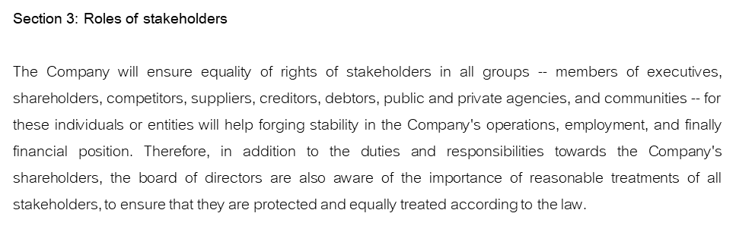

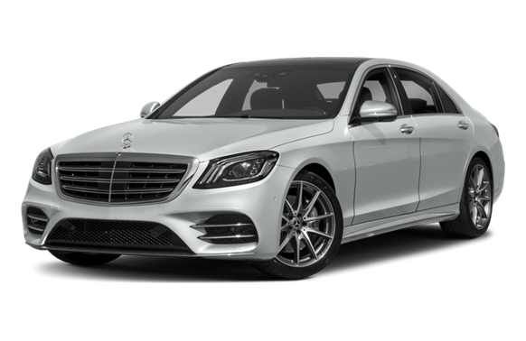
a) Shareholders
The Company focuses on appropriate returns to shareholders by performing appropriate actions to consistently maintain and increase results of the business operations, as well as internal control system appropriate and sufficient to protect the interests of the Company and its shareholders.
b) Customers
The Company recognises the importance of the customers. It focuses, as a result, on customer satisfaction by offering quality service, complete and accurate information pertaining to the Company's business operation, to build understanding and confidence among customers. The Company has also opened up a channel to receive questions and complaints, in order to gain the highest level of satisfaction of the customers.
In 2017, the Company organised customer-relation activities, elaborated below:
Event | Times | Participants (Company)
Safe Driving Activity | 5 | 5
Safety Day Booth on the premises of customer’s company. | 2 | 2
Visit to Car Assembly Factory | 2 | 37
Toyota Save and Safe | 1 | 20
Test Drive (Vios) | 1 | 17
34

Slide 37


c) Employees
The Company selects and recruits its members of staff based on their ability and working experience. It also focuses on continual development of the employees, on opening up opportunities for them to create a stability in their career, including career advancement. The Company treats all employees equally and provides adequate welfares and benefits:
Provident fund: as a reward for their diligence
Uniforms: the Company provides all employees with proper uniforms, including work boots for employees whose job is servicing cars, to promote safety
Annual Health Check-up: to promote health among employees
Employee Excellence Award: the Company awards a number of its employees every three month, to recognise their serious contribution to the Company
The Window of Knowledge: the Company provides for the need of knowledge, by allocating “book corner” for employees to borrow and read at their disposal, including a bulletin board presenting useful information concerning the business, tax, social security, and other related legal issues.
Improvement of Skill and Knowledge: the Company consistently organises workshops and training session in several topics in an effort to continuously improve skills and knowledge of the employees. The sessions are both held in premises by external experts or organised as field trip. The Company also encourage inter-departmental exchange of knowledge within the Company.
In 2017, the company deployed its employees, including directors and executives, to participate in events organised by various organisations in order to improve knowledge and skills, e.g. Training in knowledge in accountancy and tax works with Dharmaniti Training and Seminar Co., Ltd; Technical training to improve mechanical skills among mechanics with Nissan Motors (Thailand) Training Centre.
35

Slide 38
Employee training record
Description | Year 2016 | Year 2017
Number of employees | 275 | 281
Training hours | 1,650 | 1,967
Health and Safety Statistics
Average days absent from work of employees | Year 2016 | Year 2017
Sickness absence (Days/Person) | 0.33 | 2.26
Work related injury and sickness absence (Days/Person) | 1 | 1
Accident (Times) | 1 | 1
d) Management Executives
The Company realises the importance of management executives as one of the key personage who is driving the business to success. Therefore, a fair structure of renumeration has been created in accordance with the industrial renumeration standard, including welfare and benefits, etc.
e) Creditors and Trading Partners
The Company is committed to conduct business with all types of suppliers and creditors ethically and fairly by adhering to the commercial terms, mutually-agreed terms and conditions, and to the related law and regulations.
f) Competitors
The Company treats business competitors fairly and does not conduct unlawful business or violate trading ethics in order to compete with the competitors. The Company is committed to strictly follow commercial terms, mutually-agreed terms and conditions, and to the related law and regulations.
g) Responsibility Towards Community, Society, and Environment
The Company conducts business by taking the impact against community, society, and environment, into account; including concerns towards and cooperation with community, society, and environment, in accordance with related law and regulations.
The Company has disclosed and published the information about Sustainability Report for the year 2017 in a separate report and is available for viewing on the company's web site at www.krungthai.co.th
h) Respect Towards Intellectual Property Policy
The company recognises the ownership and intellectual property rights of other persons. Therefore, in conducting any business that is associated with other person’s intellectual property in terms of reproduction, adaptation, or broadcast, the company must have a permission from the righteous owner of such intellectual property.
36

Slide 39
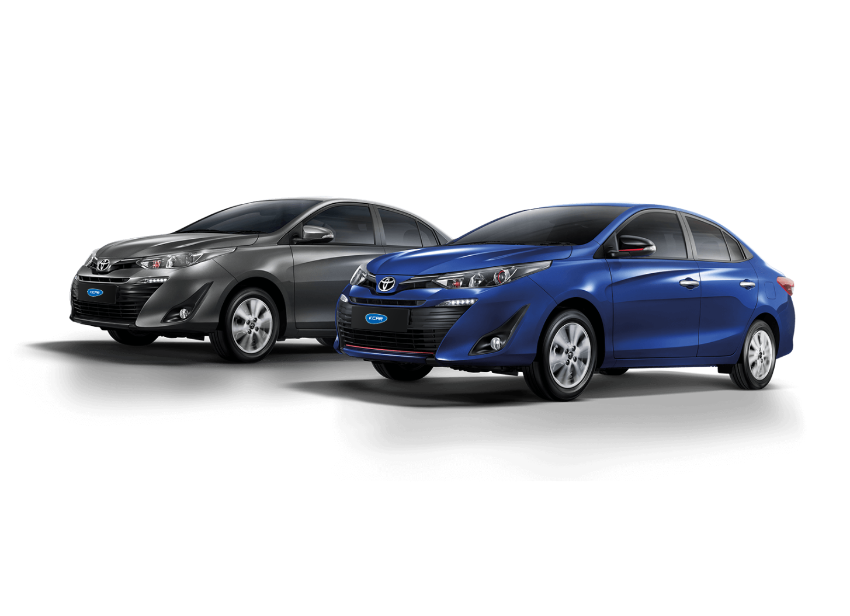
Section 4: Disclosure of Information and Transparency
The Company focuses on the disclosure of information that is complete, accurate, transparent, timely, and verificable, to facilitate stakeholders and related parties in monitoring the Company's business operations.
The Board of Directors is responsible for the disclosure of the Company's information system financial and non-financial for shareholders, stakeholders to receive equal treatment under the law.
The Company recognises the importance of thorough and transparent disclosure of information concerning the Company's business operations and relevant informations essential to the price of the securities of the Company by disseminating information through the SET Community Portal System, or SCP, and in various media for investors and analysts to receive complete information. The Company also distributes its information through its web site at www.krungthai.co.th. For those who are interested in general information or would like to inquire about additional information, they are welcome to contact the Company at telephone number 02-291-8888.
Disclosure of Significant Financial and Non-Financial Information
1) Disclosure of annual and quarterly financial statements shall be validated and reviewed by auditor and approved by the board of directors. The board recognises its responsibility for financial report and guarantees that the information is accurate, complete, true, and reasonable.
2) Disclosure of the names and biographies of the members of the board, members of committees, sub-committees, and executives.
3) Disclosure of remuneration information of the board of directors and the executives.
4) Disclosure of information on shareholding of the company’s shares by board members and executives.
5) Disclosure of information or transactions that may be associated with conflict of interests.
6) Disclosure of roles and duties of each board member, and sub-committees concluded during the past year, e.g. the number of meetings attended.
Section 5: Responsibilities of Directors
The Board of Directors plays an important role in corporate governance for the benefit of the Company, responsible for performance of duties to the shareholders, in possession of leadership and control over the management effectively.
The Company clearly separates the roles and responsibilities between the board of directors and the executives. The board of directors is responsible for setting policies and supervising the operations of the company. Meanwhile, the management of the company is assigned to manage various aspects in accordance with the policy. Therefore, the chairman of the board and the board member shall be treated as two separate individuals. Both positions must be elected by the board of directors in order to appoint the best individual for the job. In addition, the board of directors shall take the responsibility of determining the succession plan of top executives. The plan is reviewed annually with only the presence of members who are non-executive directors.
37

Slide 40
The chairman of the board shall not be an executive director and shall not take part in the management of the company.
The company assigns the company management executives an authority to operate under the policies related to overal performances, to control the expenditures and the budgets according to the scope as set in the annual plan approved by the board of directors.
(a) Composition and Qualifications of the Board
1. The board is composed of no less than five and no more than 12 directors, half the number of directors present shall be independent directors.
2. Each board member shall be perfectly knowledgeable and expert in operations of the Company. No less than two of the board members shall be knowledgeable in car rental business for operation. No less than one of the board members shall be knowledgeable in accountancy and finance. And no less than one of the board members shall be knowledgeable in legal issues.
3. Each board member shall be meeting the qualifications and not possessing the prohibited characteristics prescribed in the Public Limited Company Act, and not lacking suitability to be confided in being a managerial personage in the business where the general public is investing in, according to the SET and SEC regulations.
4. The Company has published the biographical information of all members of the board in (56-1) and Annual Report (56-2), including on the Company's web site.
(b) Duty and Authority of the Board
As mentioned in section “Duty and Authority of Directors”, 8 subsections atogether.
c) Duty and Authority of the Audit Committee
The Audit Committee is composed of at least three of the Company's members of the board, in which one-third of the members are knowledgeable in accountancy and finance. Each member of the Audit Committee shall meet the qualifications presribed by the SEC and SET regulations pertaining to the qualifications of the audit committee. Their duty is to audit and regulate the Company's operations, financial report, internal control, consideration of conflict of interest, as well as the Company's risk management.
The duty and authority of the audit committee is mentioned in subject “Duty and Authority of the Audit Committee” 7 subsections altogether.
(d) Duty and Authority of the Directors
The duty and authority of the directors is mentioned in subject “Duty and Authority of the Board of Directors”, 8 subsections altogether.
(e) Duty and Authority of the Nominating and Remunerating Committee
The duty and authority of the Nominating and Remunerating Committee is mentioned in subject “Duty and Authority of the Nominating and Remunerating Committee”, 3 subsections altogether.
38

Slide 41
(f) Duty and Authority of the Corporate Governance Committee
The duty and authority of the Corporate Governance Committee is mentioned in subject “Duty and Authority of the Corporate Governance Committee”, 4 subsections altogether.
(g) Duty and Authority of the Risk Management Committee
The duty and authority of the Risk Management Committee is mentioned in subject “Duty and Authority of the Risk Management Committee”, 4 subsections altogether.
(h) Development of Committee Members
The board of directors is encouraged to train and educate the relevant executives and employees on the company’s corporate governance system, such as directors, audit committee members, and independent directors. They shall be trained by the Stock Exchange of Thailand, Thai Institute of Directors, Securities and Exchange Commission.
When there is a change to the position of directors and the first time a new director is elected, the company shall arrange an orientation session to benefit the formance of the new director. The orientation may include the introduction of the company, the company’s businesses, and business guidelines. Appropriate and relevant training courses shall be provided to the new director.
(i) Leadership
The Board of Directors has prescribed the policy, strategies, objectives, as well as budgeting, so as to promote efficiency in the business operation, by regulate performance of the management according to the plans, and defining, elaborating roles and responsibilities of the Board of Directors, management body, employees and stakeholders. Furthermore, the Audit Committee is also responsible for the control and evaluate the performance of the internal control department and its operations, including the internal control system in which the risk management is to be controlled, to ensure protection of interests of the Company.
(j) Conflict of Interest
Although the Company is composed of the Board of Directors, the management and executive bodies, as well as all parties of employees, some of which are also holding shares of the Company. The Company's operation policy aims at the interest of the corporation as a whole, particularly decisions on issues that are a risk to create conflict of interests. The Company policy is prescribed that members of the board, and management executives who are also shareholders of the Company do not have the right to vote on conflict-of-interest oriented issues in order to bring about more independent decisions. The decisions are to be announced publicly, e.g. in financial statement, and in the annual report form 56-1, for the sake of transparency. As for the use of inside information, the Company is required to report any change of its share composition and ownership to the Securities and Exchange Commission under Section 59 of the Secutities and Exchange Act of B.E. 2535. In addition, disclosure of inside information to unrelated or third parties, nor change in the structure of shares is allowed before the dissemination of the Company's financial statement.
(k) Business Ethics
The Company has established its code of conduct according to the business ethics as guidelines for the Board of Directors, the management executives, and working parties, to conduct the business operation with fairness and honesty. The Company firmly believes that the good governance will elevate the standard of governance in the Company, as well as promote confidence amongst investors in the capital market.
39

Slide 42
Other Good Governance
(1) Directors Structure
The Company has total 6 directors as listed as follows:
The Company follows rules of Securities and Exchange Commission and regulation of Stock exchange regarding to the number of Independence director and audit committee member. Under the regulation, the one-third of the Board of Directors must be Independence director and not less than 3 persons. The Company has Independence director and audit committee member total 3 persons which follows the above mentioned regulation.
(2) Aggregation or Segregation
The Chairman of the Board of Director must not be the same person as managing director because both of them are representative of the same shareholders group and also being the major shareholders. Therefore, there is the policy when they make the important decision; it’s required to pass resolution from all director groups in the important making decision. Therefore the important decision making shall be approved by the resolution of all groups of directors especially for the Audit Committee to provide independent opinion in order to balance and review the management process.
(3) Remuneration of Directors, Executives Committee and Executive
The Company has set the remuneration to director at the average level of the industry which is concerns on duty and responsibility of directors, including maintaining of the qualified directors. The remuneration of executives will be based on the individual’s and the Company’s performance. The remuneration will be made with transparency and being approved by shareholders. The Company will disclose the remuneration policy and remuneration of directors and executives in annual report according to the regulations of the Securities and Exchange Commission.
(4) The Board of Directors’ Meeting
The Board meets once every quarter and the relevant documents shall be sent to the directors 7 days in advance to afford the director sufficient to make the proper review and study. There is a secretary who is responsible for the meeting and takes minute of the meeting and filling properly.
However, during the year, if there is the agenda for policy or business issues to be considered, the Company will call an interim Board of Directors meeting as appropriate.
Name | Executive Parent Company/Director | Executive Subsidiary Company/Director | Audit Committee Member
1. Mr. Pithep Chantarasereekul | / | /
2. Mr. Pichit Chantarasereekul | / | /
3. Mr Karoon Laoharatanun | /
4. Mr. Chaiwat Atsawintarangkun |  |  | /
5. Mrs. Supaporn Jittmittraparp |  |  | /
6. Assoc Prof Dr Pasu Decharin |  |  | /
 | 4 persons | 3 persons | 3 persons
40

Slide 43
Meetings of the audit committee may be held as they see fit without presence of executive directors to provide an opportunity for audit committee to discuss questionable issues of the company’s business and subjects in the interest of the directors. The meeting may allow the presence of auditor so that he or she can give insights from the accountancy aspect. The meeting shall produce a meeting report for the board of directors.
During year 2016 and year 2017, the Board met total 7 and 9 times a year the list of attendance of each of directors is follows:
^{/1}Mr Paitoon Chantarasereekul, deceased on September 3, 2016.
^{/2} Pol Lt Gen Noppakao Thanyasiri resigned from the position of the member of the board of directors. The meeting appointed Assoc Prof Dr Pasu Decharin to fill the vacancy on December 15, 2016.
(5) Sub Committee
The Board of Directors has appointed Sub Committees to supervise the Company’s business. The Audit Committee is one of Sub Committee that has tenure not over than 3 years, consisting of at least 3 independent directors who are not the executive. However, in the future, the Board of Directors may appoint the Sub Committee of remuneration, nomination and others as appropriated and needed.
(6) Monitor and Internal Control System
The Company set an Internal Audit Function to be responsible for the internal control system and audit the significant transaction s regularly to ensure that there is the efficiency system and support the reliability of the financial statement. In addition the Audit Committee also reviews the efficiency of the internal system including the operation and compliance control for risk management and focus on the any unusual transactions.
(7) Report of the Board of Directors
The Board of Directors is responsible for the Company’s financial statement and financial information which discloses in the annual report. These financial statements have been prepared in accordance with Thai generally accepted accounting principles. The Company selects the appropriate accounting policies and
Name of Board of Directors | 2016 |  | 2017
 | Number of meeting during his/her tenure | Number of meeting during his/her tenure | Number of meeting during his/her tenure | Number of meeting during his/her tenure
1. Mr. Paitoon Chantarasereekul ^{/1} | 3 | 3 | - | -
2. Mr. Pithep Chantarasereekul | 7 | 7 | 7 | 7
3. Mr. Pichit Chantarasereekul | 7 | 7 | 8 | 8
4. Mr Karoon Laoharatanun | 7 | 7 | 7 | 7
5. Mr. Chaiwat Atsawintarangkun | 7 | 7 | 8 | 8
6. Mrs. Supaporn Jittmittraparp | 7 | 7 | 8 | 8
7.Police Lieutenant General Nopkao Thanyasiri^{/2} | 7 | 4 | - | -
8. Assoc Prof Dr Pasu Decharin ^{/2} | 1 | 1 | 7 | 6
41

Slide 44
uses these policies consistently and discrete with carefully as well as sufficient disclosed the significant information in the note to financial statements.
(8) Investors Relationship
The Board of Directors focuses on the important in disclose the finance and non-finance information therefore the Company has a policy to disclose correctness, completeness, on timely basis and transparency in accordance with the standards and regulations of The Stock Exchange of Thailand. The Company will present this information to all shareholders, investors and stakeholders equally in order to understand the Company clearly and correctly then people will accept the Company and being interested to invest. Moreover, the Company will receive the good public view which is the one target and strategy of the Company.
(9) Information Disclosure and Transparency
The Company places importance on the disclosure of information accurately, completely, transparently and freely both for financial statements and general information, and also other information that would impact the price of the Company property. And to ensure that the investors and all other related parties have free access to the information, these information are to be publicised through different media channels such as website of the Stock Exchange of Thailand, form 56-1, annual reports, and at the Annual General Meeting of shareholders.
Protection of Inside Information Usage for Executives
The Company has a policy and procedure for using the inside information especially, the information which has not disclosed to public yet to protect the seeking for their own interests as well as for securities trading benefits as followings:
To educate the directors and executives in all functions about the responsibility to report the each person’s securities holding and the holding of securities by his/her spouse and minor children to the Securities Exchange Commission and The Stock Exchange of Thailand under the section 59 and penal provision under section 275 notified in Securities and Exchange Act, B.E. 2535.
The Company assigns the executives to report the change in securities holding to the Securities Exchange Commission and The Stock Exchange of Thailand under the section 59 notified in Securities and Exchange Act B.E. 2535 and to submit the copy report to the Company in the same day of submission report to the Securities Exchange Commission and The Stock Exchange of Thailand.
The Company will send the memorandum to inform the executives who receives the significant inside information which will affect to the change in securities price to refrain trading in securities for the period of one month before the financial statement and inside information public and prohibit disclosing this significant information to any other persons
The company has set the penalty by nature as appropriate however the Company will use the maximum penalty if it is proven that the executives or other related party use the internal information or behave in a way that make the Company or shareholders being damaged and ruin. The maximum penalty is the dismissal from the Company without any compensation.
42

Slide 45
Business Ethics
The Company intends to operate the business with integrity, ethics, compliance with the law, and the responsibility for the overall economy and the society, by adhering to the following virtues: honesty, justice, transparency, and benefits for shareholders and stakeholders – as a good practice. The company, therefore, has written up a set of ethical guidelines for executives and employees of all levels to adhere to, to disseminate a good image of the company in order to gain society’s confidence. The business approach is as follows.
The Company operates legal business, does not engage in unlawful business operations, and encourage employees to abide by the law.
The Company operates its business with integrity, including accurate accounting records. It also spends budget economically and with transparency, while evaluating investment projects with honesty, accuracy, and transparency within the set principles.
The company strongly believes that honesty, ethics, and virtue are the foundation of sustainable business operation.
The company only conducts and supports the conduct of lawful activities and transactions according to the organisation’s ethical principles.
Anti-Corruption Policy
The company realises the importance of the business operations under good governance principles by putting emphasis on honesty, transparency, responsibility, and awareness of rules and regulations set by the law and by relevant standards. In 2015, the company decided to sign up for the “Alliance of Anti-Corruption Practices in Private Sector” to express the company’s determination to eradicate any forms of corruption.
To guarantee that the company has laid out a series of policy to set responsibilities, procedures, and regulations on appropriate actions to prevent any corrupted activities in the company’s business transactions. And to prevent the risk of corrupted activities, the company has written up a set of “Anti-Corruption Guidelines” to express clear policy in operating business, so that the company advances itself to the promising sustainable development.
This report only reveals certain parts of the “Anti-Corruption Policies”, the full article on anti-corruption policies are available for viewing on the company’s web site www.krungthai.co.th
Definition
Corruption means bribery of any forms offered by promising to give, deliberately offering, or asking for money or other benefits other than those specified in the code of conducts for government and private sector workers, or for persons of direct and indirect authority, to coerce or force person or persons to wrongly refraining to perform duties so that the business can go on as planned, so that the business is referred to by suggestion, or so that the business can secure its wrongly-earned benefits. The code of conducts can be exempted on the exception of the law, regulations, announcement, rules, traditions, local traditions, or trading customs.
43

Slide 46
Responsibilities
1) Member of the Board of Directors have the duties to prescribe policies, ensure that the operations happen, and supervise the efficient anti-corruption system so that they can be certain that the executives realize and are aware of the anti-corruption efforts on the level that it has become organizational culture.
2) Member of the Audit Committee have the duties to inspect the financial report and related accountancy details, internal control system, and the risk management system, to ensure internationally accepted practices, with conciseness, suitability, modernization, and efficiency.
3) Directors, Administrators, and Executives have the duties to ensure the existence of supporting system for the anti-corruption policy so that the company may be able to communicate with its employees and related persons. They also have duties to revise the policy so that it can be used in any possible changing situations, for example, business conditions, regulations, and rules of the law.
4) Internal Auditors have the duties to check and inspect that the operations are up to the policy and regulations, protocols, and laws; so that the control system is suitable and sufficient for the possible corrupted activity that may emerge; and report to the Audit Committee.
5) Board of Directors, Executives, and Employees must carry on their duties within the guidelines stated in the policy. Should they see or witness any wrongdoing or any activity that violates the policy, they are obliged to report to their respective superior through channels specified in the policy.
Regulations and protocols for corruption prevention
General chapter
1) Board of Directors, Executives, and Employees of all levels shall adhere to the anti-corruption policy and the ethics by not being engaged in corruption, no matter it is a direct or indirect involvement.
2) Employees shall not neglect when they see or witness any misconduct or activity related to the company’s operation that can be considered corruption. They are obliged to report to their respective superiors and cooperate with the inspections. Questions can be asked through their respective superiors or persons appointed to follow up on the ethics through designated channels.
3) The company will provide fair treatment and protection to employees who deny or report the suspicious activity related to the company’s business operation on the basis of the protection measures for whistleblowers or reporters of corrupted activity.
4) The company provides sufficient and appropriate internal control on a timely basis to prevent employees from veer off from the regulations, especially on the departments of sales, marketing, and purchasing.
5) Those found to have committed misconduct or corruption are considered to have violated the company’s code of ethics and shall be considered for disciplinary penalties according to the company’s rules, plus civil penalty if the subject is also found to have violated the law.
6) The company realizes the importance of spreading words, knowledge, and making understood with other people whose work is related to or can affect the company’s business operation, in terms of anti-corruption policy.
7) The company is determined to build and preserve the organizational culture that adheres to the principle against corrupted activities toward government and private sectors.
44

Slide 47
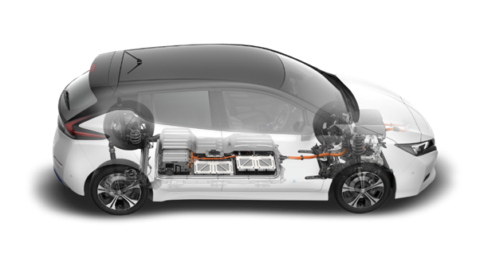
Risk Assessment
1) The company’s executives shall have an understanding about possible risks emerged from bribery and corruption. They shall also communicate with all levels of employees so that they understand and cooperate with the company in order to eradicate such risks with effiency.
2) The company regularly conducts risk assessment from business transactions which may involve certain procedures that is within the scope of bribery or corruption. The company shall revise its policy on risk management at least once a year. The company shall also revise its measures on risk management so that it’s suitable for preventing or reducing the risks to somewhat satisfactory level.
Training and Communication
1) Members of the Board of Directors, Executives, and Employees
a) Members of the Board of Directors, Executives, and Employees shall be trained and instructed continually about anti-corruption policy so that they realise the importance of the policy, especially on many forms of corruption, on risk emerged by involvement in corrupted activity, procedures of reporting of misconduct or suspicious activity.
b) Members of the Board of Directors, Executives, and Employees shall receive their own copy of the anti-corruption policy or they can find it on the company’s intranet, to ensure that everybody acknowledges and understands the anti-corruption policy. Besides, the updated version of the policy can be consulted at the company’s web site.
c) Trainings on the knowledge of this policy shall be a part of the orientation session for new position on the levels of the company’s Members of the Board of Directors, Executives, and new employees.
2) Dealer, Business Intermediaries, Distributors of Merchandises and/or Services, and Contractors
The company shall communicate the anti-corruption policy to dealers, business intermediaries, distributors of merchandises and/or services, and contractors from the very beginning of the business relationship or after the business relationship, as appropriate. The company encourages dealers, business intermediaries, distributors of merchandises and/or services, and contractors, to adhere to the same social responsibility standards as the company’s.
45

Slide 48
Whistleblowing and Submission of Petition
Should any Member of the Board of Directors, Executives, or Employees, have doubts or evidence about involvement in any corruption activity by any Member of the Board of Directors, Executives, Employees, or any person who conduct business in the name of the company, they shall report or inform the company accordingly:
Members of the Board of Directors, Executives, and Employees, can submit petition directly, verbally or in document through the following channels:
By phone: 02-291-8888 ext 120 (Mr Noppol Sakthong)
By e-mail: noppol@krungthai.co.th
Over the company’s web site at www.krungthai.co.th
By mail to:
Khun Noppol Sakthong / Company’s Secretary
Krung Thai Car Rent and Lease Public Company Limited
455/1 Rama III rd, Bang Khlo
Bang Kho Laem, Bangkok, 10120
The company will keep the identity of the whistleblower or petitioner a secret and use the information given for the betterment of the company’s internal management and operations. It will only disclose the given information upon request by authorised representative of the law enforcement, court order, request of the Security Exchange Commission, or relevant government and authority agencies.
Whistleblowers and their petitions are to be seriously considered. They will also be protected against unlawful authority and actions to oppose the whistleblowing or petitioning.
The whistleblowers shall act honestly. If the company finds out that the petition was ill-intentioned, deliberately attacking or defaming others, the company will be forced to take action accordingly.
Investigation and penalties
When the company is informed about wrongdoing, the management and the auditing committee shall filter, investigate, and find the truth. The two committees may appoint a representative (one of the executives) report the findings to the informant or the petitioner on a timely basis.
If the truth finding finds that the accusation of corruption is well-grounded, the company will give the accused some time to know about the accusation and to prove oneself by presenting counter-evidence that exonerates one from the accusation.
If the accused was found to have really committed corruption as stated in the anti-corruption policy, the accused shall be punished according to the penalty up to dismissal of employment or dismissal from his or her present position. If the deed in question is considered unlawful according to the law, the accused shall receive punishment as the law requires. The penalties according to the company executives are considered ultimate.
46

Slide 49
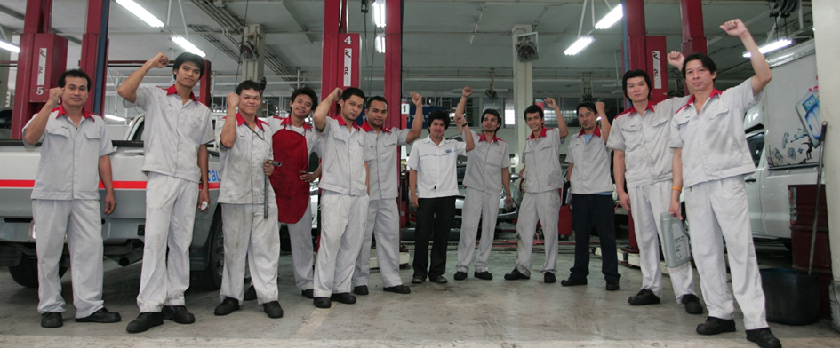
Inspection and Verification
1. The company regularly conduct inspection and verification of the policy (at least once a year) by taking into account the changing situations and risks. The findings of the inspection and verification are to be reported directly to the Board of Directors about the results of risk management and suggestions in order to reduce risk factors.
2. The inspection division shall regularly conduct inspection of internal control and report the findings in a timely manner so as to ensure efficiency of internal control system in its anti-corruption tasks. The inspection division shall also discuss with relevant personnel to seek appropriate solution, report on the findings directly to the Board of Directors and the Audit Committee accordingly.
47

Slide 50
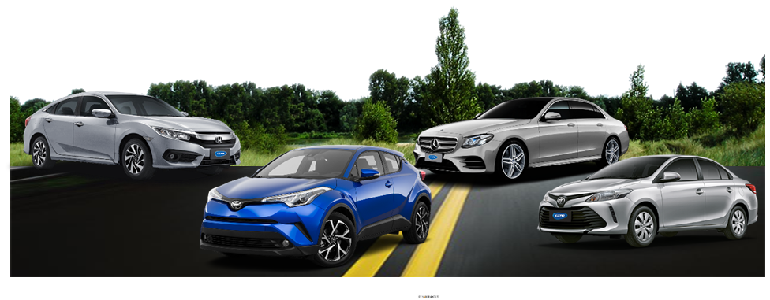
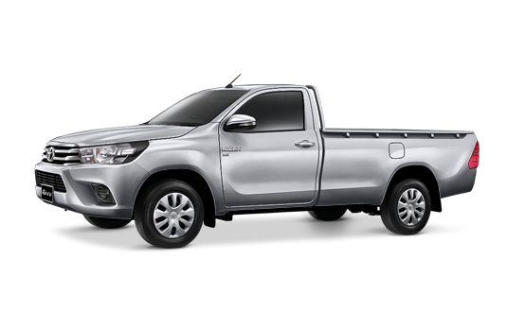
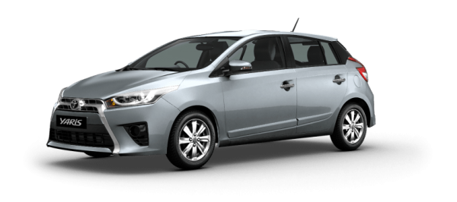
Corporate Social Responsibility
The Company has disclosed and published the information about Sustainability Report for the year 2017 in a separate report and is available for viewing on the company's web site at www.krungthai.co.th
Internal Control
The Board of Directors had the opinion that the internal control system of the Company is sufficient and in accordance with the Evaluation Internal Control System of the Securities and Exchange Commission and the Stock Exchange of Thailand, especially the internal control in regarding to the business with the major shareholders directors executives and related parties. The Company has the compact and sufficient internal control as well as the Company has set the Internal Audit function to be responsible for submission the audit report to the Audit Committee. The Internal Auditor has the audit scope and internal operation to make the correct and efficiency in control system and good management.
48

Slide 51
Related Party Transaction
The Company had transactions with related party which might lead to conflict of interest transactions. The transactions were the transactions with shareholders and/or executives of the Company including the transactions with the related companies which have the same shareholders and executives. These transactions are disclosed in the note to financial statements and audited by the auditor of the Company as well as the disclosure in the Audit Committee Report which can be summarized the relationship and detail of related party transactions as bellows:
Conflict of Interest Parties | Relationship
Thanapat Property Company Limited | Mr. Paitoon Chantarasereekul, being authorized director and shareholder represent 4% of total issued capital of the Company and being authorized director and shareholder represent 22.22% of Thanapat Property Company Limited
 | Mr. Pithep Chantarasereekul, being authorized director and shareholder represent 13.6% of total issued capital of the Company and being authorized director and shareholder represent 22.22% of Thanapat Property Company Limited
 | Mr. Pichit Chantarasereekul, being authorized director and shareholder represent 13.6% of total issued capital of the Company and being authorized director and shareholder represent 16.67% of Thanapat Property Company Limited
 | Mrs.Wipaporn Chantarasereekul, being authorized director and shareholder represent 16.2% of total issued capital of the Company and being authorized director and shareholder represent 22.22% of Thanapat Property Company Limited
 | Ms.Pimonpan Chantarasereekul, being authorized director and shareholder represent 7.92% of total issued capital of the Company and being authorized director and shareholder represent 5.56% of Thanapat Property Company Limited
 | Ms.Pimonta Chantarasereekul, being authorized director and shareholder represent 8.09% of total issued capital of the Company and being authorized director and shareholder represent 5.56% of Thanapat Property Company Limited
 | Mr.Pisit Chantarasereekul, being authorized director and shareholder represent 10% of total issued capital of the Company and being authorized director and shareholder represent 5.56% of Thanapat Property Company Limited
Siam Nissan Krungthai Company Limited | Mr. Paitoon Chantarasereekul, being authorized director and shareholder represent 4% of total issued capital of the Company and being authorized director and shareholder represent 2.5% of Siam Nissan Krungthai Company Limited
 | Mrs. Wipaporn Chantarasereekul, being authorized director and shareholder represent 16.2% of total issued capital of the Company and being authorized director and shareholder represent 2.5% of Siam Nissan Krungthai Company Limited
 | Mr. Pichit Chantarasereekul, being authorized director and shareholder represent 13.6% of total issued capital of the Company and being authorized director and shareholder represent 25% of Siam Nissan Krungthai Company Limited
 | Ms. Pimonpan Chantarasereekul, being authorized director and shareholder represent 7.92% of total issued capital of the Company and being authorized director and shareholder represent 5% of Siam Nissan Krungthai Company Limited
 | Ms. Pimonta Chantarasereekul, being authorized director and shareholder represent 8.09% of total issued capital of the Company and being authorized director and shareholder represent 5% of Siam Nissan Krungthai Company Limited
 | Mr. Pisit Chantarasereekul, being authorized director and shareholder represent 10% of total issued capital of the Company and being authorized director and shareholder represent 60% of Siam Nissan Krungthai Company Limited
Toyota Krungthai Company Limited | Mr. Pithep Chantarasereekul, being authorized director and shareholder represent 13.6% of total issued capital of the Company and being authorized director and shareholder represent 60% of Toyota Krungthai Company Limited
 | Mr. Pichit Chantarasereekul, being authorized director and shareholder represent 13.6% of total issued capital of the Company and being authorized director and shareholder represent 19.23% of Toyota Krungthai Company Limited
 | Mrs. Wipaporn Chantarasereekul, being authorized director and shareholder represent 16.2% of total issued capital of the Company and being authorized director and shareholder represent 19.23% of Toyota Krungthai Company Limited
 | Ms.Pimonpan Chantarasereekul, being authorized director and shareholder represent 7.92% of total issued capital of the Company and being authorized director and shareholder represent 0.38% of Toyota Krungthai Company Limited
 | Ms.Pimonta Chantarasereekul, being authorized director and shareholder represent 8.09% of total issued capital of the Company and being authorized director and shareholder represent 0.38% of Toyota Krungthai Company Limited
 | Mr.Pisit Chantarasereekul, being authorized director and shareholder represent 10% of total issued capital of the Company and being authorized director and shareholder represent 0.38% of Toyota Krungthai Company Limited
49

Slide 52
Conflict of Interest Parties | Relationship
Carloft Auto Import Company Limited | MissPimonpan Chantarasereekul, being authorized director and shareholder represent 7.92% of total issued capital of the Company and being shareholder represent 32.50% of total issued capital of Carloft Auto Import Company Limited
 | MisssPimonta Chantarasereekul, being shareholder represent 8.09% of total issued capital of the Company and being shareholder represent 16.25% of Carloft Auto Import Company Limited
 | Mr. Pisit Chantarasereekul, being shareholder represent 10% of total issued capital of the Company and being authorized director and shareholder represent 8.13% of Carloft Auto Import Company Limited
Mrs.Wipaporn Chantarasereekul^{/1} | Being shareholders represent 16.20% of total issued capital of the Company
Mr. Pithep Chantarasereekul^{/1} | Being authorized director and shareholders represent 13.60% of total issued capital of the Company and daughter of Mrs.Wipaporn Chantarasereekul
Mr. Pichit Chantarasereekul^{/1} | Being authorized director and shareholders represent 13.60% of total issued capital of the Company and daughter of Mrs.Wipaporn Chantarasereekul
MissPimonpan Chantarasereekul^{/1} | Being shareholders represent 7.92% of total issued capital of the Company and daughter of Mrs.Wipaporn Chantarasereekul
MissPimontha Chantarasereekul^{/1} | Being shareholders represent 8.09% of total issued capital of the Company and daughter of Mrs.Wipaporn Chantarasereekul
Mr. Pisit Chantarasereekul^{/1} | Being shareholders represent 10% of total issued capital of the Company and daughter of Mrs.Wipaporn Chantarasereekul
50

Slide 53
Related Party Transactions
List of Leases and Assets leased out Transactions
2. Purchasing Assets Transactions
 |  |  | Amount ( Million Baht
Nature | Conflict of Interest Parties | Pricing Policy | Period ended 31 Dec. 2016 | Period ended 31 Dec. 2017
Leased Assets Transaction
The Company rents the building size 1,490 sq.m. for being Service Center and allocated to be parking space size 3,000 sq.m. located in Rama III Road, Khet Bangkolaem Bangkok. The rental agreement has 3 years life starting from 20 Feb. 18 to 19 Feb. 21. The rental revenue is Baht 100,000 per month and the Lessor can adjust the rental revenue not over than 10% in every 3 years period A subsidiary company has signed a lease of a plot of land of 187.5 square wa | Siam Nissan Krungthai Co.,Ltd. | A rental revenue is Baht100,000per month | 1.20 | 1.20
2. A subsidiary company has signed a lease of a plot of land of 187.5 square. | Thanapat Property Co.,Ltd | Monthly rental fee of 50,000 baht (266.67 baht per square metre per month) | 0.84 | 0.84
.3. The subsidiary company is currently leasing a plot of land of 2,400 sq wa, with the deed number 6567, situated on Phaholyothin road, Senanikhom, Chatuchak, Bangkok, on a 2-year contract dated January 1, 2018 to December 31, 2020. | Toyota Krungthai Co., Ltd. | Rental fee according to the contract at: 150,000 baht | 1.80 | 1.80
List of Assets leased out
1. The Company has building for rent size 350 sq.m. being Car Showroom located in Rama III Road Khet Bangkolaem Bangkok. The rental agreement has 3 years life starting from Feb.18 to Feb 21. | Siam Nissan Krungthai Co., Ltd. | A rental fee is Baht 83,000 per month (represent Baht 237.14 per sq.m.) | 1.00 | 1.00
2. The subsidiary leases office space 1,200 square meters to be used as a car showroom, located on Srinakarin Road, Prawet, Bangkok. The lease contract is 3 years starting from August 2017 to July 2020 | Carloft Auto Import Co., Ltd. | Rental fee is Baht 80,644.86 per month. (Baht 71.91 per square metre) | 1.04 | 1.04
Nature | Conflict of Interest Parties | Pricing Policy | Amount ( Million Baht)
 |  |  | Period ended 31 Dec. 2016 | Period ended 31 Dec. 2017
1. The company purchased car for being leased out. | Toyota Krungthai Company Limited | Market price for major buyer | 969.04 | 398.80
Account payables – Car purchasing |  |  | - | -
2. The company purchased car for being leased out | Siam Nissan Krungthai Company limited | The Company purchased cars at cost price after deduct special discount. | 34.99 | 15.99
Account payables – Car purchasing |  |  | - | -
3. The company purchased car for being leased out Account payables – Car purchasing | Carloft Auto Import Company limited | Market price for major buyer | 38.07 - | 18.92 -
51

Slide 54
3. List of Guarantee for loan from banks
The Audit Committee’s Opinion
The Audit Committee has the opinion that the above transactions are reasonable and beneficial to the business operation as follows:
1. Leases and Assets leased out Transactions
The Company rents building space for office and service center and leased building out for car showroom in the fair price and reasonable, which can be compared with rental revenue of offices nearby and in the rental revenue rate to premier customers of the operating lease and car leased out companies in fair price and reasonable.
2. Purchasing Assets Transactions
The transaction is the cars and auto parts purchasing for business operation as the leased out assets with fair price. This price can be compared with other distributors with the normal course of business. Starting from year 2004, the Company has a policy to purchase cars at market price by comparing price with other distributors and purchase the same model with the lowest price or addition option with the highest value.
3. Guarantee for loan from banks transactions
The transactions are reasonable and they are the condition for borrowing money from the Commercial Banks which is considered to be the highest benefit to the Company with no fee charges for the guarantee from the loans for purchasing leased out cars and loans for the liquidity of the Company.
Nature | Conflict of Interest Parties | Pricing Policy | Amount ( Million Baht)
 |  |  | Period ended 31 Dec. 2015 | Period ended 31 Dec. 2016
1. Mr Pithep Chantarasereekul secured a bank loan for the company with Kbank PCL for an overdraft of 10 million baht. The secured short-term loan was in the form of a promissory note at the amount of 130 million baht, and a letter of guarantee at the amount of 130 million baht. | Mr. Pithep Chantarasereekul | No fee | - | -
2. Mr Pichit Chantarasereekul secured a bank loan for the company with Kbank PCL. The secured loan was in the form of a promissory note at the amount of 80 million baht, and a letter of guarantee at the amount of 100 million baht. | Mr. Pichit Chantarasereekul | No fee | - | -
52

Slide 55
Necessary and Reasonable of the Related Party Transactions
1. Leases and Assets leased out Transactions
1.1 The Company rented the building for being Service Center from Siam Nissan Krungthai Company Limited and allowed Siam Nissan Krungthai Company Limited rented some part of the building for distributing Nissan Cars. The both buildings located in the same area in Rama III Road. The Company owns the right of the lease space in front of the main road and Siam Nissan Krungthai Company Limited owns the right of the lease space at the back side. Later on the Company has expanded the business therefore the Company additional rented the back space to be Service Center and Siam Nissan Krungthai Company Limited rented some part of the front space to be Showroom with the fair price which can be compared with the rental space of the offices nearby. The Company is necessary to do this transaction because this agreement occurred before the Company is listed in the Stock of Exchange of Thailand.
The agreement notified that the Company will use the land in the front side for construction office building and Siam Nissan Krungthai Company Limited will use the land at the back side for construction repairing cars service center. Later on the Company has expanded the business, the Company has addition used the office space at the back side for customer services area. Therefore the Company rented that space from Siam Nissan Krungthai Company Limited and in the meantime Siam Nissan Krungthai Company Limited rented the front side to be used for parking areas of selling cars for the showroom of Nissan Car distributors. This is the consequence from the past agreement and will continue throughout 10 years agreement and ended at 31 March 2015. However there is extended this agreement and will end on Feb. 2021.
  1.2 Subsidiary leased land to be Toyotasure Krungthai Showroom, Sri Nakarin Branch and the branch office. And this subsidiary leases some part of land to Carloft Auto Import Co., Ltd. for being showroom for selling imported cars. Both of buildings are located in the same area on Sri Nakarin Road and the rental revenue are under the agreed upon. Such related parties are responsible for utilities expenses and common area management charges.
2. Purchasing Assets Transactions
The Company purchased cars, auto parts and tools from Siam Nissan Krungthai Company Limited and Toyota Krungthai Company Limited for its business operation with the fair price which can be compared to other distributors. In the future, if there is the addition related party transactions of purchasing assets, the Company will assign the Audit Committee to consider the price whether this transactions is needed and reasonable in order to be the highest benefits to the Company and shareholders. The Company expects that these related transactions will occur again because the Company has the policy for customer to select the brand of the cars while the Company will allow other distributors to propose the price for competition. The distributor that offers the best package will be selected.
3. Guarantee for loan from banks transactions
Mr .Pithep Chantarasereekul and Mr.Pichit Chantarasereekul are the guarantors for the short-term loans and long-term loans from the Commercial Banks with no fees charged. The Company has the necessary to have the capital for business operations therefore the major shareholders group has to support this borrowing from the Commercial Banks. The Company will operate in the fair deal if the guarantee fee charged is involved. The Company will use the fair and competitive price with market which this price has to be approved by the resolution from the Audit committee. However, the major shareholders group has the policy to support the borrowing with no fees charged.
53

Slide 56
Measures and Procedures of Transaction Approval
The company has laid out a set of measures and procedures of transaction approval by disallowing the company’s executives and stakeholders into the approvals of transaction. The company has appointed the Audit Committee to take part and give professional opinions on the appropriateness of each transaction. As for the policy of transaction-making between the company and person(s) with possibility of conflict of interest, the company shall clearly designate transaction detail, price, and related conditions so that the Audit Committee can verify and disclose such information in the actual financial remarks. The company also set the code of conducts in transaction-making for normal business operation as follow:
1) Trade transaction under normal business operation with general trade conditions
Limitation of Financial Amount in Long-Term Lease Agreements
Limitation of Financial Amount | Authorised Person in Normal Trade Transaction
 | Transaction with Third-Party | Transaction with Person with Conflict of Interest
Less than 3 million baht | Senior Managers for Marketing and Legal Affairs | Senior Managers for Marketing and Legal Affairs
More than 3 million baht to less than 6 million baht | Senior Vice President for Business Supports | Senior Vice President for Business Supports
More than 6 million baht to less than 20 million baht | Vice President | Vice President
More than 20 million baht to less than 50 million baht | Managing Director | Board of Directors
More than 50 million baht to less than 100 million baht | Executive Committee | Board of Directors
More than 100 million baht | Board of Directors | Board of Directors
Financial Amount |  | Authorised Person in Normal Trade Transaction
 |  | Transaction with Third-Party | Transaction with Person with Conflict of Interest
Less than 3 million baht |  | Administration Manager and Vice President for Business Supports | Administration Manager and Vice President for Business Supports
More than 3 million baht to less than 6 million baht |  | Vice President for Business Supports | Vice President for Business Supports
More than 6 million baht to less than 20 million baht |  | Vice President | Vice President
More than 20 million baht to less than 50 million baht |  | Managing Director | Executive Committee
More than 50 million baht to less than 100 million baht |  | Executive Committee | Board of Directors
More than 100 million baht |  | Board of Directors | Board of Directors
54

Slide 57
2) Trade transactions under normal business operations and business supports activity without trade conditions; or other transactions out of the company’s business areas.
The company shall organise a meeting of Audit Committee to conduct preliminary approval prior to the transaction-making, and organise an approval session through a meeting of the Board of Directors and the Audit Committee to ensure fair approval of transaction-making with appropriate pricing policy where certain Board of Directors with conflict of interest are not allowed to vote in the meeting. If the Audit Committee is found to not have the suitable capability to consider or approve certain transactions, the company shall hire an independent expert to give professional opinions on the transaction in question to the Audit Committee, Members of the Board of Directors, or shareholders accordingly.
55

Slide 58
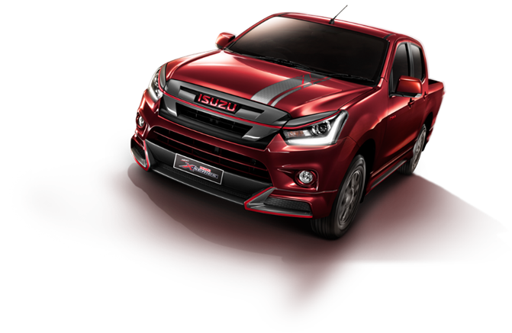
Policy and Trends of Future Transactions
The company has laid out a set of policy for future transactions by setting rules and regulations according to the actual trade in market prices comparable to prices quoted by third party. The company shall involve the Audit Committee or independent experts in the consideration to ensure reasonable prices and appropriateness of the transaction for the sake of transparency, in line with the good governance policy.
As for future transactions, the company shall conduct according to the laws, decrees, or announcements on securities and exchange constituted by the Stock Exchange of Thailand. The company shall also conduct in compliance with the regulations about disclosure of transaction and the sources and targets of funds which are considered prominent assets of the company or the subsidiary company.
56

Slide 59
Financial Highlights
 | Consolidated Financial Statements
รายการ | 2015 | % | 2016 | % | 2017 | %
STATEMENT OF COMPREHENSIVE INCOME (Million Baht)
Income on car leases | 1,138.01 | 58.49 | 1,132.80 | 56.56 | 1,146.92 | 54.81
Income on sale of cars | 746.84 | 38.38 | 807.51 | 40.32 | 886.26 | 42.36
Other income | 60.93 | 3.13 | 62.65 | 3.13 | 59.21 | 2.83
Total expenses | 1,693.56 | 87.04 | 1,670.33 | 83.39 | 1,779.59 | 85.05
Profit before income tax expenses | 320.82 | 16.49 | 400.07 | 19.98 | 389.15 | 18.60
Finance cost | 68.59 | 3.52 | 67.43 | 3.37 | 76.35 | 3.65
Income tax expenses | 48.79 | 2.51 | 2.04 | 0.1 | (27.64) | (1.32)
Profit for the year | 203.44 | 10.46 | 330.6 | 16.51 | 340.44 | 16.27
STATEMENT OF FINANCIAL POSITION(Million Baht)
Total assets | 3,819.20 | 100 | 4,639.50 | 100 | 4,999.09 | 100
Total liabilities | 2,032.55 | 53.22 | 2,657.29 | 57.28 | 2,985.18 | 59.71
Total shareholders' equity | 1,786.65 | 46.78 | 1,982.22 | 42.72 | 2,013.91 | 40.29
Authorized share capital shares of Baht 1.00 each | 250 |  | 250 |  | 250
Book value per share
Profit (Loss) per share (Baht) | 0.81 |  | 1.32 |  | 1.36
Dividends per share (Baht) | 0.45 |  | 1.02 |  | 1.06
Financial Ratios
Gross Profit Margin (Excluding Profit on Sale of Rental Assets) (%) | 19.62% |  | 20.95% |  | 18.06%
Gross Profit Margin (Including Profit on Sale of Rental Assets) | 22.80% |  | 26.30% |  | 24.85%
Operating Margin | 16.49% |  | 19.97% |  | 18.60%
Net Profit Margin | 10.46% |  | 16.51% |  | 16.27%
Return on Assets (ROA) | 8.61% |  | 9.46% |  | 8.07%
Return on Equity (ROE) | 11.70% |  | 17.54% |  | 17.04%
57

Slide 60
Financial Ratios
 | 2015 | 2016 | 2017
Profitability Ratio
Gross Profit Margin (Excluding Profit on Sale of Rental Assets) | 19.62% | 20.95% | 18.06%
Gross Profit Margin (Including Profit on Sale of Rental Assets) | 22.80% | 26.30% | 24.85%
Operating Margin | 16.49% | 19.97% | 18.60%
Net Profit Margin | 10.46% | 16.51% | 16.27%
Liquidity Ratios
Current Ratio | 0.47 | 0.57 | 0.53
Asset Turnover | 0.52 | 0.47 | 0.43
Efficiency Ratio
Return on Assets (ROA) | 8.61% | 9.46% | 8.07%
Return on Equity (ROE) | 11.70% | 17.54% | 17.04%
Leverage Ratio
Debt/Equity Ratio | 1.14 | 1.34 | 1.48
Interest Coverage Ratio | 4.68 | 5.93 | 5.10
Dividend Payout Ratio | 55.56% | 77.30% | 90.44%
Book value per share | 7.15 | 7.93 | 8.06
Profit (Loss) per share (Baht) | 0.81 | 1.32 | 1.36
58

Slide 61
Management Discussion and Analysis
Overview of the Business
The company’s financial position and results of operation of the year as of December 31, 2017, in conclusion are as follow:
The consolidated financial statement of the company is 2,092.39 million baht, accounted to 340.44 million baht of net profit, 4,999.09 million baht of total assets. The consolidated financial statement for 2017 increased by 359.09 million baht or 7.8% from the previous year’s financial statement of 4,639.50 million baht. The total assets comprise 8,344 cars for lease and cars awaiting sales worth 3,966.92 million baht, representing an increase from the figure dated December 31, 2016 of 8,226 cars worth 3,812.71 million baht. The increase of total assets emerged from the purchase of 1,774 cars, while the number of sales of lease-expired cars in 2017 of 1,655 cars increased from the previous year by 119 cars. The 2017 book value increased by 207.54 million baht.
In addition, the subsidiary company last year concluded the establishment of a new branch of Toyota Sure to support the sales growth of secondhand cars. The book value increased by 28 million baht and the purchase of second-hand cars increased by 10.23 million baht at the end of 2017 to prepare for sales at the new branch.
Meanwhile, the total liabilities as of December 31, 2017 accounted to 2,985.18 million baht, representing an increase from the previous year by 327.88 million baht or 12.34% compared to the previous year’s total liabilities of 2,657.29 million baht. The increase of total liabilities emerged from procurement of additional cars for lease, and financial institution debenture. The proportion of fixed-interest long-term loan against floating interest rate in 2018 and 2017 is 81:19 and 73:27 respectively.
The total liabilities for the shareholders’ part as of December 31, 2017 accounted to 2,013.91 million baht, representing an increase of 31.70 million baht or 1.60% against 1,982.22 million baht of the previous year. The accrued profit before dividends accounted to 1,908.96 million baht. The company paid out dividends of 307.50 million baht. As of the end of 2017, the company reports the accrued profit of 2017 at 1,601.46 million baht.
Results of Operations
Revenue
In 2017, the company enjoyed a total revenue of 2,092 million baht, representing an increase from the previous year by 89.42 million baht or 4.46% up from the previous year’s total revenue of 2002.97 million baht. The total revenue is from the following operations:
1) Revenue from Car Lease
The company has received a total of 1,146.92 million baht in lease fees in 2017, representing an increase of 14.12 million baht or 1.25% against the previous year’s figure of 1,132.80. Of the revenue from total car lease fees, the margin (excluding revenue from sales of lease-expired cars) was accounted to 18.06%, representing a drop of 2.89% against the previous year. The proportionate increase in 2017 lease fees was resulted by increased long-term lease contracts of 1,988 cars, 636 cars more than the total number of 1,352 lease-expired cars. This caused an increase in lease fees when compared to the period of lease contracts concluded in 2016 of 3 years. However, the new contracts concluded in 2017 are 4-5 years long, resulting in a slight drop of lease fees per car when compared to the same car models and lease contracts.
59

Slide 62
2) Revenue from Sales of Lease-Expired Cars
The company has received a total of 694.56 million baht from sales of lease-expired cars, representing an increase of 9.75%. The increase was enjoyed due to an increasing number of lease-expired cars sold of 1,655 cars in 2016 or an increase of 195 cars or 13.4%, against the previous year’s number of 1,460 cars. The increase was partly caused by a newly-opened and stimulated online channel opened in 2016, and a recent auction session as a part of the promotional activities to increase the number of cars sold and prices tagged.
3) Revenue from Sales of Cars of Subsidiary Company
The revenue received by the subsidiary company in 2017 totalled 191.70 million baht, or an increase of 17.85 million baht against the previous year’s revenue of 178.85 million baht, representing an increase of 7.18%. The increase in revenue from car sales was caused by a larger number of medium- and large-sized cars sold in 2017 than in 2016, where as the medium- and large-sized cars are more expensive than small-sized cars even the number of cars sold in 2017 and 2016 were the same, 383 cars.
Costs and Expenses
1. Cost of leasing operation in 2017 totalled 939.84 million baht, representing an increase by 44.31 million baht from the previous year. In the year 2016, the cost of leasing operation totalled 895.53 million baht, representing an increase of 4.95%. The reason the operation cost in 2017 increased was caused by the increasing depreciation cost incurred from the larger rental car portfolio, and a drop in lease fee collection as most clients switched from the previously concluded 3-year contracts to longer terms of contract of 4-5 years following tighter cost control on the clients’ side, making the receivable lease fees dropped. However, the company did manage well to control the principal costs, where in 2017, the cost of car reparation, maintenance, and insurance fees was equal to the figure recorded at the end of year 2016 although the number of cars in the 2017 fleet of 8,338 exceeded the 2016 fleet of 8,226 by 112 cars. The cost of reparation was spread into the company’s repair centres and mobile units, which helped bringing down the cost of maintenance and reparation. By the means of insurance fees, the company organised an accident control strategy and encourage clients to take safety driving course, bringing the insurance fee per car down considerably compared to that of the previous year.
2. Cost of operation in sales of lease-expired cars in 2017 totalled 422.82 million baht, representing an increase of 9.37% or 50.37 million baht against the previous year’s figure of 386.77 million baht. The increasing cost of operation in sales of lease-expired cars perfectly corresponds to the increase in car sales. The cost of sales depended on ages, models, and types of cars.
3. Cost of operation in sales of second-hand cars by the subsidiary company in 2017 totalled 165.29 million baht, representing an increase of 14.31 million baht or 9.48% against the previous year’s figure of 150.97 million baht. The increase in the cost of operation was because the car sales in 2017 involved more large- and medium-sized cars, whose prices were higher.
60

Slide 63
4. Administrative costs, which comprises employee spendings, marketing expenses, advertising and public relation budgets, utility bills, land lease, etc., in 2017 totalled 175.29 million baht, or 8.38% of the total revenue. The cost of operation of 2017 increased by 5.7 million baht of 3.34% against the previous year’s figure of 169.62 million baht, or 8.47%% of the total revenue of 2016. The large proportion of the increase was the in employee spending.
Net Profit and Return
The company’s net profit recorded as of the end of 2017 accounted to 340.44 million baht, an increase by 9.84 million baht or 2.98% against the previous year’s figure of 330.60 million baht. The increase was rooted from two factors, as follow:
1. Increase in profit from leasing fees: In 2017, the profit of leasing fees totalled 1,146.92 million baht, representing an increase of 14.12 million baht or by 1.25%. The previous year’s figure was 1,132.80 million baht. The increased profit perfectly corresponded to the increasing number of long-term lease contracts, which was more than the number of expired contracts.
2. Increase in profit from sales of lease-expired cars: In 2017, the profit of lease-expired cars totalled 271.74 million baht, representing an increase of 29.85 million baht or by 12.34%. The previous year’s figure was 241.89 million baht. The increased profit perfectly corresponded to the increasing number of cars sold.
3. Drop in payable tax: In 2017, the company reportedly paid 27.64 million baht of tax, representing a drop compared to the previous year’s payable tax of 2.03 million baht. The steep drop was reached thanks to the recent change tax exemption scheme stated in the royal decree issue nº 604 (2016) dated April 18, 2016. The royal decree permits the exemption of corporate income tax for 100% of investment in assets for 5 tax years. As a result, the company was economised of payable tax in 2016 by 60 million baht and in 2017 by 91 million baht, a year-on-year increase of 31 million baht.
61

Slide 64
Assets
As of December 31, 2017, the company owned a total of 4,999.09 million baht in assets, representing an increase of asset worth in 2016, of 4,639.50 million baht by 359.59 million baht or an increase of 7.8%.
The company’s principal assets in the portfolio are 8,344 cars in stock worth 3,966.92 million baht, representing an increase from the previous year’s figure of 8,226 cars worth 3,812.71 million baht. The increase was from 2017 purchase of 1,774 cars for lease. The company sold a total of 1,655 lease-expired cars, making the total number of cars in stock rose by 119 cars, thus rendering the book value of the asset increased by 207.54 million baht.
In addition, the subsidiary company last year concluded the establishment of a new branch of Toyota Sure to support the sales growth of secondhand cars. The book value increased by 28 million baht and the purchase of second-hand cars increased by 10.23 million baht at the end of 2017 to prepare for sales at the new branch.
Accounts receivable
Taking into consideration the quality of accounts receivable, the accounts receivable (prior to deduction of allowance for doubtful accounts) as of December 31, 2017 totaled 131.21 million baht, decreased by 5.54 million baht or 4.05% from the previous year, while the accounts receivable as of the end of 2016 totaled 136.75 million baht. The accounts receivable (after deduction of allowance for doubtful accounts) as of December 31, 2017 was equal to 124.52 million baht. Of which, 44.62 million baht emerged from car sales, and 79.90 million baht from car lease. The accounts receivable in car sales are the accounts in the financial institutions. As for the accounts receivable in terms of car lease, 61.45 million baht or 76.90% is yet to reach payment due. In response to the information, the company is closely monitoring the debt with customer selection criteria based on level of credibility and financial position. The majority or 95% of the company’s customers are corporate accounts from government agencies, state enterprises, and private companies, which have positive histories of payment. However, the company has set a preventive measure by earmarking allowances for doubtful accounts according to the policy as follow:
units
Description | For the year ended 31 December
 | 2015 | 2016 | 2017
Cars at the beginning of the periods (units) | 6,562 | 6,967 | 8,226
Purchased during periods (units) | 1,633 | 2,719 | 1,774
Sold during periods (units) | 1,228 | 1,460 | 1,655
Cars at the ended of the periods (units)
- cars held for sales | 277 | 753 | 423
- cars held for leased | 6,690 | 7,473 | 7,922
Total cars at the ended of periods | 6,967 | 8,226 | 8,345
Net book value at ended of periods (Million Baht)
- cars held for sales | 85.68 | 177.35 | 124.03
- cars held for leased | 3,097.45 | 3,635.35 | 3,842.89
Total Net book value at ended of periods | 3,183.13 | 3,812.70 | 3,966.92
62

Slide 65
Outstanding receivables for the period 0f more than 1-2 month(s) 1%
Outstanding receivables for the period of more than 2-3 months 2%
Outstanding receivables for the period of more than 3-6 months 50%
Outstanding receivables for the period of more than 6 months 100%
Accounts receivable can be analyzed as followings
Details of accounts receivable ledger
Source of Funds
Liabilities
As of December 31, 2017, the company had in record a total of 2,985.18 million baht in liabilities, representing an increase from December 31, 2016 by 327.89 million baht or 12.34% of the total liabilities recorded at the end of 2016 at 2,657.29 million baht. The increase of liabilities was produced by purchases of new cars for lease using the loans taken from financial institutions. The total liabilities as of December 31, 2017 accounted to 2,985.18 million baht, representing 59.71% of the total assets. Of which, 49.64% was the current liabilities and 50.36% was the non-current liabilities, compared with the total liabilities as of December 31, 2016 of 2,657.29 million baht, or 57.28% of the total assets in 2016. Of which, 50.81% was the current assets while 50.36% was the non-current assets.
However, such a proportion of liabilities in the system does not affect the liquidity management as the company continuously operates the car rental business. In addition, it could also liquidate from the sales of lease-expired cars. This kind of business operates on liabilities as capital. The company must work to manage the cash inflow and outflow to the perfect balance in order not to risk losing liquidity in terms of both timely manner and interest rates by designating the debt payment period in accordance with the car lease period and by finding the right source of fund with stable interest rates to correspond with the stable lease fees to minimise the risk of interest rate volatility.
(Unit : Millions Baht)
Description | As at 31 December 2015 | As at 31 December 2016 | As at 31 December 2017
Undue | 111.75 | 101.04 | 106.08
Not exceed 3 months | 12.85 | 30.99 | 16.75
3 – 6 months | 0.99 | 1.73 | 2.44
Over than 6 months | 2.59 | 2.99 | 5.95
Total | 128.18 | 136.75 | 131.21
Less: Allowance for doubtful accounts | (2.84) | (6.18) | 6.68
Net | 125.34 | 130.57 | 124.53
(Unit : Millions Baht)
Description | As at 31 December 2015 | As at 31 December 2016 | As at 31 December 2017
Receivable from rental car | 83.85 | 85.87 | 79.90
Receivable from selling car | 41.49 | 44.70 | 44.63
Total | 125.34 | 130.57 | 124.53
63

Slide 66
((Unit : Millions Baht)
The liabilities under hire purchase and finance leased contracts can be summarized as followings:
Shareholders’ Equity
The company's shareholders’ equity as of December 31, 2017 was accounted to 2,013.91 million baht, which has increased from the previous year’s figure of 1,982.22 million baht. The increase was produced by the improved performance of the company with a net profit of 339.21 million baht, while dividend was paid twice to its shareholders in 2017.
At the ordinary shareholders’ meeting for the year 2017 held on April 17, 2017, the shareholders unanimously approved to pay dividend from the Company operation year 2016 to the shareholders with Baht 1.02 per share, in the amount of Baht 255 million. The dividend paid in the amount of Baht 75 million, appropriated for 250,000,000 shares of Baht 0.30 each was paid on September 9, 2016, and the remaining in the amount of Baht 180 million, appropriated for 250,000,000 shares of Baht 0.72 each was paid on May 12, 2017.
And at the committees’ meeting No 3/2017 held on August 4, 2017, the Committees unanimously approved to pay interim dividend from the Company operation for the period ended June 30, 2017 in the amount of Baht 127.50 million, appropriated for 250,000,000 shares of Baht 0.51 each was paid on September 1, 2017.
Total dividend for the year 2017 in the amount of Baht 307.50 million.
Capital Structure
The company purchases cars in order to do leasing business by using funds taken according to purchase agreement (as of the end of 2017, representing 80% of a long-term loan) which is a normal practice in this kind of business. As it is a productive loan in return for assets crucial for the company’s business operations, the loan can be utilised to manage the cash flow of the company, as it is also in conform to the company’s policy of utilisation of sources of funds. Apart from the balancedness in the company’s cash flow, the management of interest can be done easily thanks to non-volatility nature of the rate of interest.
In conclusion, the company’s selection process of sources of fund involves the balanced movements between cash inflow and outflow, number of lease contracts agreed, and financial cost, to produce the utmost efficiency in financial management and business operations of the company.
Description | As at 31 December 2015 | As at 31 December 2016 | As at 31 December 2017
Not exceed one year | 424.47 | 329.78 | 231.17
1 – 3 years | 572.09 | 348.53 | 114.91
Total | 996.56 | 678.31 | 346.08
64

Slide 67
Liquidity
In 2017, the company registered a total of net cash flow of 130.31 million baht from its business operations, which increased by 356.75 million baht compared to the previous year’s figure of 226.44 million baht. It is because in 2017, the company purchased a smaller number of new cars for lease in cash compared to the previous year. Part of the cash flow worth 26.38 million baht was acquired from the company’s investment activities, an increase of the previous year by 27.47 million baht. 29.78 million baht was spent in purchasing fixed asset of a construction of the new Toyota Sure branch.
Net earning from sales of securities held for sale worth 56.50 million baht, and earning from interest worth 1.03 million baht. As for the cash flow in the company’s business activities in 2017, a part of cash flow worth 70.60 million baht, representing a steep drop from the previous year by 402.46 million baht. Of which, 112.19 million baht was the taken short-term loan, 517.72 million baht of taken long-term loan, 70.78 million baht of interest expense, 332.23 million baht of loan payment of purchase orders, and 307.50 million of dividend payment. In conclusion, the company’s liquidity in 2017 increased by 86.10 million baht.
The details of future income under operating leased which cannot be terminated are as follows:
Auditors’ remuneration Audit fee
In 2017, the Company appointed Miss Sulalit Ardsawang, CPA No. 7517 from Dharmniti Auditing Company Limited to serve as the Company’s auditors and its subsidiaries, respectively. The total audit fees for the year 2017 of Baht 1,190,000 divided into the audit fees for Company of Baht 875,000 and its subsidiaries of Baht 315,000.
(Unit : Millions Baht)
Future income | As at 31 December 2015 | As at 31 December 2016 | As at 31 December 2017
Not exceed 1 year | 919.06 | 971.33 | 1,020.38
Over 1 year but not exceed 5 years | 1,218.81 | 1,569.42 | 1,673.37
Total | 2,137.87 | 2,540.75 | 2,693.75
65

Slide 68
Directors and Executives’ Profile
Name |  | Age | Education /List of Management Committee trained | Holding Shares Proportion | Family Relation during Executives | 5 years previous working experience
Position |  | (Year)
Identification Number
 |  |  |  | (%) |  | Period | Position/Company
1 | Mr. Pithep Chantarasereekul | 47 | - MBA-Faculty of Finance, | 13.6 | Son of Mr. Paitoon Chantarasereekul | 2004 - Present | Director and Managing Director/Executive Director
 | The Chairman of the Board of Directors |  | Seattle University, United States |  |  |  | Krungthai Car Rent and Lease Public Company Limited
 |  |  | - BBA- Business Administration, |  |  | 2005 - Present | Director
 |  |  | Assumption University |  | and brother of Mr. Pichit Chantarasereekul |  | Krungthai Automobile Company Limited (Buy and Sale Used Cars)
 |  |  | - DAP 19 |  |  | 2004 - Present | Managing Director
 |  |  | - DCP 201/2015 |  |  | 1992 -Present | Toyota Krungthai Company Limited (Toyota Distributor)
 |  |  |  |  |  | 1998 - 2003 | Director
 |  |  |  |  |  |  | Thanapat Property Company Limited (Rental Building)
 |  |  |  |  |  |  | Deputy Managing Director
 |  |  |  |  |  |  | Krungthai Car Rent International Company Limited
2 | Mr. Pichit Chantarasereekul | 45 | - MBA- Business Administration, | 13.6 | Son of Mr. Paitoon Chantarasereekul and younger brother of Mr. Pithep Chantarasereekul | 2004 - Present | Director and Deputy Managing Director/Executive Director Krungthai Car Rent and Lease Public Company Limited
 | Director and Managing Director Executive Director |  | University of Toledo, United States |  |  |  | Director
 |  |  | - BBA- Business Administration |  |  | 2005 - Present | Krungthai Automobile Company Limited (Buy and Sale Used Cars)
 |  |  | Assumption University |  |  |  | Managing Director
 |  |  | - DAP 19 |  |  | 2003 - Present | Siam Nissan Krungthai Company Limited (Nissan Distributor)
 |  |  | - DCP 85 |  |  |  | Director
 |  |  | - CDC 8 |  |  | 1992 - Present | Thanapat Property Company Limited (Rental Building)
 |  |  | - FBS 2/2015 |  |  |  | Deputy Managing Director
 |  |  | - RNG 7/2015 RCC 20/2015
3 | Mr. Karoon Laoharatanun | 61 | - MBA, Kasetsart University | -No- | -No- | Mar 2013-Present | Director
 | Director |  | - Bachelor of Science, Kasetsart |  |  |  | Krungthai Car Rent and Lease Public Company Limited
 |  |  | University |  |  | 2008 - Present | President of Infonet (Thailand) Co., Ltd.
 |  |  | - DAP 32 |  |  | 2008 - Present | President of Siam Telecom Access Co., Ltd.
 |  |  | - DCP 170 |  |  | 2008 - Present | President of STC Network Corporation Co.,Ltd.
 |  |  | - Automobile Financing Business at Kuala Lumpur, Malaysia
66

Slide 69
Directors and Executives’ Profile
Name |  | Age | Education /List of Management Committee trained | Holding Shares Proportion | Family Relation during Executives | 5 years previous working experience
Position |  | (Year)
Identification Number
 |  |  |  | (%) |  | Period | Position/Company
4 | Mr. Chaiwat Atsawintarangkun | 65 | - Thai-Barrister-At-Law -The Thai Bar Association | - No - | - No - | 2004 - Present | Director and the Chairman of Audit Committee
 | Director and the Chairman of Audit Committee |  | - MBA |  |  |  | Krungthai Car Rent and Lease Public Company Limited
 |  |  | Business Administration Thammasat University |  |  | 1997 - Present | Executive Partner
 |  |  | - BBA |  |  |  | Prospect Consulting Company Limited (Auditing and Finance Advisory)
 |  |  | Business Administration Ramkhamhaeng University |  |  | 2001 - 2002 | Subcommittee of Financial Advisory
 |  |  | Faculty of Law Ramkhamhaeng University |  |  |  | Forest Industry Organization
 |  |  | - DAP 24, DCP 81, ACP 12
5 | Mrs. Supaporn Jittmittraparp | 51 | - MBA- Faculty of Law, | - No - | - No - | 2004 - Present | Director and Audit Committee member
 | Director and Audit Committee member |  | Villanova University , United States |  |  |  | Krungthai Car Rent and Lease Public Company Limited
 |  |  | - DAP 23, DCP 160 |  |  | 2002 - Present | Managing Director
 |  |  |  |  |  |  | Smart Home System Company Limited (Electronic System and Securities Consulting)
 |  |  |  |  |  | 2002 - Present | Managing Director
 |  |  |  |  |  |  | Pacific Challenge Holding Company Limited (Investment in other companies)
 |  |  |  |  |  | 2002 - Present | Managing Director
 |  |  |  |  |  |  | Innovative Technology System Company Limited
 |  |  |  |  |  |  | (Production, Design. Creation and distribution the Innovation)
67

Slide 70
Directors and Executives’ Profile
Name |  | Age | Education /List of Management Committee trained | Holding Shares Proportion | Family Relation during Executives | 5 years previous working experience
Position |  | (Year)
Identification Number
 |  |  |  | (%) |  | Period | Position/Company
6 | Assoc Prof Dr Pasu Decharin | 50 | - PH.D. MANAGEMENT OF TECHNOLOGY, SCHOOL OF | - No - | - No - | Dec. 16- Present 2011-Present 2015-Present 2015-Present 2015-Present | Audit Committee member
 |  |  |  |  |  |  | Krungthai Car Rent and Lease Public Company Limited (Car Operating Leasing) Dean of Faculty of Commerce and Accountancy Chulalongkorn University
 | Director and Audit Committee member |  | MANAGEMENT,
 |  |  | - (MBA) University, Of Colorado ,USA (BBA) Faculty of Commerce and Accountancy Chulalongkorn University |  |  |  | Director AACSB International Director EPAS Accreditation Board Vice President and Executive Committee Association of Asia Pacific Business Schools
7 | Mr. Sakditouch Chantarasereekul | 45 | -MBA- Business Administration, Faculty of Finance, | - No - | Grandson of | 2007-Present | Assistant Senior Managing Director
 |  |  | Drexel University, Pennsylvania,USA
 | Senior Assistant Managing Director Business Support |  | - BBA- Business Administration, |  | Mr. Paitoon Chantaraseree kul |  | Krungthai Car Rent and Lease Public Company Limited
 |  |  | Faculty of Management
 |  |  | Assumption University
 |  |  | - DCP169
 |  |  |  |  | and counsel of
 |  |  | Chief Financial Officer Certification Program No. 12 from Federation of Accounting Professions DCP 169 ACPG 22/2015 ELP 4/2016 (DCP)
 |  |  |  |  | Mr. Pithep Chantarasereekul and Mr. Pichit Chantarasereekul
9 | Miss Sirima Cha-emkun | 46 | -MBA- Business Administration, Sripatum University | - No - | - No - | 2007 – Present | Managing Director of Service
 | Managing Director of Service |  | - BBA- Business Administration-Faculty of Management, St.John University |  |  |  | Krungthai Car Rent and Lease Public Company Limited (Car Operating Leasing)
 |  |  | -Mini MBA 57
 |  |  | Thammasat University
68
67

Slide 71
Directors and Executives’ Profile
Name |  | Age | Education /List of Management Committee trained | Holding Shares Proportion | Family Relation during Executives | 5 years previous working experience
Position |  | (Year)
Identification Number
 |  |  |  | (%) |  | Period | Position/Company
10 | Miss Jittiya Luangjamekorn | 42 | - BBA- Faculty of Fine Art, Chulalongkorn University | - No - | - No - | 2008 – Present | Senior Manager – Marketing
 | Senior Manager - Marketing |  |  |  |  |  | Krungthai Car Rent and Lease Public Company Limited
 |  |  | - Visual Basic Version 6 Training
 |  |  | - Advanced VB For Web Application Developer – Internet & E-commerce Training |  |  | 2001 – 2007 | Marketing Manager
 |  |  |  |  |  |  | Krungthai Car Rent and Lease Public Company Limited
 |  |  | Thammasat University
11 | Miss Pornpan Sattawatkul | 43 | - BBA- Faculty of Accounting, Siam University | - No - | - No - | 2005 - Present | Finance and Accounting Manager
 | Finance and Accounting Manager |  |  |  |  |  | Krungthai Car Rent and Lease Public Company Limited (Car Operating Leasing)
 |  |  | - CPA No. 7287
 |  |  |  |  |  | 2000 - 2004 | Accounting Manager
 |  |  |  |  |  |  | J T C Inside Company Limited
 |  |  |  |  |  |  | (Law and Accounting Consultant, Auditing Firm)
12 | Noppol Sakthong Secretary | 53 | - BBA, Faculty of Low Ramkhamheng University - Company SECRETARY PROGRAM- Thai Institute of Directors | - No - | - No - | 2004-Present | Secretary Krungthai Car Rent and Lease Public Company Limited (Car Operating Leasing)
68
69

Slide 72
Detail of positions of Board of Directors, Executives and Controlled Power
persons in subsidiary and related parties as at 31 December 2017
= Director
= The Chairman of the Board of Directors
= Executive Director
        = Audit Committee
        = Authorized Director
        = Managing Director
 | Company | Subsidiary | Related Parties
 |  |  | Thanapat Property Company Limited | Siam Nissan Krungthai Company Limited | Toyota Krungthai Company Limited | Carloft Auto Import Company Limited
1. Mr. Pithep Chantarasereekul
2. Mr. Pichit Chantarasereekul
3. Mr Karoon Laoharajatanand
4. Mr. Chaiwat Atsawintarangkun
5. Mrs. Supaporn Jittmittraparp
6. Assoc Prof Dr Pasu Decharin
7. Mr. Sakditouch Chantarasereekul
8. Miss Sirima Cha-emkun
9. Miss Jittiya Luangjamekorn
10. Miss Pornpan Sattawatkul 11. Mr. Noppol Saktong
 | Subsidiary
1. Mr. Pithep Chantarasereekul
2. Mr. Pichit Chantarasereekul 3. Mr. Pisit Chantarasereekul
70

Slide 73
Report of Changes in Securities Holdings of Executives
Executives | shares
 | As at 31 December |  | Increase / (decrease | As at 31 December |  | Spouses
 | 2016 |  |  | 2017
1. Mr. Pithep Chantarasereekul | 34,000,000 | (13.6%) | - | 34,000,000 | (13.6%) | -
2. Mr. Pichit Chantarasereekul | 34,000,000 | (13.6%) | - | 34,000,000 | (13.6%) | -
3. Mr Karoon Laoharajatanand | - |  | - | - |  | -
4. Mr. Chaiwat Atsawintarangkun | - |  | - | - |  | -
5. Mrs. Supaporn Jittmittraparp | - |  | - | - |  | -
6. Assoc Prof Dr Pasu Decharin | - |  | - | - |  | -
7. Mr. Pisit Chantarasereekul | 25,000,000 | (10.0%) | - | 25,000,000 | (10.0%) | -
71

Slide 74
Report of the Audit Committee
The Audit Committee of Krungthai Car Rent and Lease Public Company Limited consists of three independent committee members. Each member of the Audit Committee is the distinct honourable persons in various disciplines – accountancy, finance, law, and so on. The three members of the independent Audit Committee have the sufficient experience to guarantee the credibility of financial report. The Audit Committee consists of the distinct persons as follow:
Mr Chaiwat Atsawintarangkun is the Chairperson of the Audit Committee
Mrs Supaporn Jittmittraparp is the member of the Audit Committee
Assoc Prof Pasu Decharin is the member of the Audit Committee
In 2017, the Audit Committee regularly held a total of four meetings to conduct their duty within the designated responsibilities stated in the Charter of the Audit Committee approved by and reported to the Board of Directors. Their responsibilities are as follow:
Financial Statement
With support and comments by the Auditor General, executives of the Accountancy Department, and the management executives have hereby revised and are responsible for the financial statements, consolidated financial statements of the company and its subsidiaries, including the financial information that appears in the annual report, the financial statements for each quarter and for the year as ended in December 31, 2017, based on generally accepted accountancy standards which is considered by the appropriate policy options and practice, and have passed the examinationfrom independent authorised auditors in a timely manner.
Internal Control and Internal Audit
The Audit Committee takes the responsibility in endorsing the annual audit report and other relevant internal audits based on reports, follow-ups, and recommendations as provided in the report. It is charged with improving and proposing an amendment of the audit process focusing on risk management in important departments and operations in order to improve the business operations. The committee also revised the internal audit adequacy evaluation and seek approval from the Board of Directors to ensure that the company’s internal audit system is sufficiently efficient for business operations.
Conflict of Interest
The Audit Committee has verified clues of conflicts of interest so that the report is in compliance with the Securities and Exchange Commission, the Stock Exchange of Thailand, and relevant rules and regulations of the law and of the government, to ensure that all transactions are in line with conventional trade practices, reasonability, and equality, without possibility of one-sided benefit. It also ensured that the disclosure of such informations comply with relevant regulations.
Certified Public Accountant
The Audit Committee takes into account and conduct recruitment for Certified Public Accountant on an annual basis. The selection criteria include their past operation results, knowledgeability, proficiency in accountancy, experience, credibility, resourcefulness, and independence. The company takes into account the suitability of audit fees based on areas of responsibility and fees in comparison with other organisations in the same level. After deliberate consideration, the Audit Committee made a selection of its Certified Public Accountant from Dharmniti Auditing Company to serve as the auditors for the company and its subsidiary. The Audit Committee nominated and sought the approval from the Board of Directors in 2018.
72

Slide 75

Corporate Good Governance
The Audit Committee has verfied and revised the good governance policies so that they are in line with the rules and regulations of the Securities and Exchange Commission and the Stock Exchange of Thailand. Some of the issues touched were rights of the shareholders, equal treatment of shareholders, roles of stakeholders, disclosure of information, transparency, and responsibility of the Board of Directors.
Compliance with Relevant Rules & Regulations
The Audit Committee has verified and revised the company’s business operations and found that they all were in compliance with relevant rules and regulations, e.g. the Securities and Exchange Commission Act, Limited Public Company Act, and all relevant rules of the law pertaining to the company’s business. The committee also revised the “Self-Evaluation Document on Anti-Corruption Measures”, which is in the course of being certified by Thailand’s Private Sector Collective Action Coalition Against Corruption (Thai-CAC).
The Audit Committee has indicated that, based on generally accepted accountancy standards which is considered by the appropriate policy options and practices on a regular basis, including reasonable estimation in the preparation of reports, as well as the disclosure of critical information in notes annexed to the financial statement, the Financial Statements of the company and its subsidiary have passed the examination and deliberation from authorised auditor or auditors who is or are independent. The financial statements, therefore, correctly reflect the financial commitment and performance in the past year, all in essence and beneficial to shareholders, and the principles of good governance.
(Mr. Chaiwat Atsawintarangkun)
Chairman of the Audit Committee
73

Slide 76


Report of the Board of Directors on Financial Reporting
The Board of Directors of KrungThai Car Rent and Lease (Public Company Limited) recognises the importance of the duty and the responsibility in the codes of conduct under good governance. The Board of Directors is responsible for the financial statements, consolidated financial statements of the company and its subsidiaries, including the financial information that appears in the annual report, the financial statements for the year as ended in December 31, 2017, based on generally accepted accountancy standards which is considered by the appropriate policy options and practices on a regular basis, including reasonable estimation in the preparation of reports, as well as the disclosure of critical information in notes annexed to the financial statement, and have passed the examination and deliberation from authorised auditor or auditors who is or are independent. The financial statements, therefore, correctly reflect the financial commitment and performance in the past year, all in essence and beneficial to shareholders, as well as general investors.
The Board of Directors has appointed an Audit Committee, which consisting of independent directors, who are responsible for overseeing the quality of financial reporting, for the evaluation of internal control systems, the risk management system, and processes that support information and financial documents in order to be productive to ensure that the accounting records are accurate, complete, timely, disorder and fraud preventing. The opinion of the committee on this issue has been set out in the report of the Audit Committee in the Annual Report for 2017.
The Board of Directors has indicated that the company's internal control system can build confidence with reason to trust the financial statements and the consolidated financial statements of the company. KrungThai Car Rent and Lease (Public Company Limited) and its subsidiaries as of December 31, 2017.
((Mr Pithep Chantarasereekul)
President
((Mr Pichit Chantarasereekul)
Managing Director
74

Slide 77
INDEPENDENT AUDITOR’S REPORT
Opinion
I have audited the consolidated financial statements of Krungthai Car Rent and Lease Public Company Limited and its subsidiary (the Group), which comprise the consolidated statement of financial position as at December 31, 2017, and the consolidated statement of comprehensive income, consolidated statement of changes in shareholders’ equity and consolidated statement of cash flows for the year then ended, and notes to the consolidated financial statements, including a summary of significant accounting policies, and I have audited the separate financial statements of Krungthai Car Rent and Lease Public Company Limited (the Company), which comprise the statement of financial position as at December 31, 2017, and the statement of comprehensive income, statement of changes in shareholders’ equity and statement of cash flows for the year then ended, and notes to the financial statements, including a summary of significant accounting policies.
In my opinion, the accompanying financial statements present fairly, in all material respects, the consolidated financial position of Krungthai Car Rent and Lease Public Company Limited and its subsidiaries as at December 31, 2017, its consolidated financial performance and its consolidated cash flows for the year then ended and the separate financial position of Krungthai Car Rent and Lease Public Company Limited as at December 31, 2017, its financial performance and its cash flows for the year then ended in accordance with Thai Financial Reporting Standards.
Basis for Opinion
I conducted my audit in accordance with Thai Standards on Auditing. My responsibilities under those standards are further described in the Auditor’s Responsibilities for the Audit of the Financial Statements section of my report. I am independent of the Company in accordance with the Federation of Accounting Professions ’Code of Ethics for Professional Accountants together with the ethical requirements that are relevant to my audit of the financial statements, and I have fulfilled my other ethical responsibilities in accordance with these requirements. I believe that the audit evidence I have obtained is sufficient and appropriate to provide a basis for my opinion.
*****/2
75

Slide 78
Key Audit Matters
Key audit matters are those matters that, in our professional judgment, were of most significance in my audit of the consolidated financial statements and separate financial statements of the current period. These matters were addressed in the context of my audit of the consolidated financial statements and separate financial statements as a whole, and in forming my opinion thereon, and I do not provide a separate opinion on these matters.
Recognition of income on car leases
The income on car leases has the transactions with significant amount in the financial statements and the transactions also affect the Company’s operation results. The income on car leases incurred from many lease agreements; each lease agreement has different rental amount and lease period. The Company has recognized the revenue by the rental period throughout the term of the lease agreement. Therefore, I have paid special attention to the above revenue recognition related to correctly and completely of income transactions have been recorded in the account.
I have audited the recognition of income on car leases by the assessed and tested the efficiency of internal control system of the Company related to the cycle of income, understand and selected the sample for operating test according to the control the Company designed from the steps in accepting customer, keying the lease agreement into the system, sampling audit lease agreements the Company entered with the customers both new and ongoing customers. It also includes assessing the efficiency of the computer system used by the Company to retrieve the billing report information. In addition, I random check the documentation on car lease incurred during the year, check near the end of the accounting period and check to the revenue recording of car lease in the general journal, including analyzing and comparing amount of average car for lease and rate of lease per car of year with revenue account on car leases to check the irregularities that may incur from income transaction on car leases.
Estimating the residual value of car for lease
The Company has revised the residual value of car for lease to follow the economic condition and close to the actual sale in during the year. There are varieties of cars and each car category has differed in residual value. The estimation of the residual value relies on considerable judgment of the management as such estimates require the significant assumptions, which are referred to the recoverable value from terminating its use or selling after the agreement expires. Such transaction has an effect on the recording of depreciation, which is the major cost in the statement of comprehensive income. Therefore,
I have paid special attention related to the judgment of the management in such estimation.
I understand the approach in considering the estimated residual value of the car for lease used by the management, assessed and tested the appropriateness of the basis used for the consideration, including analyzed and compared the recoverable value information from the sale of cars for lease with market price and experience of the actual sale in during the year.
*****/3
76

Slide 79
Other Information
Management is responsible for the other information. The other information comprises the information included in the annual report, but does not include the financial statements and my auditor’s report thereon. The annual report is expected to be made available to me after the date of this auditor's report.
My opinion on the financial statements does not cover the other information and I will not express any form of assurance conclusion thereon.
In connection with my audit of the financial statements, my responsibility is to read the other information identified above when it becomes available and, in doing so, consider whether the other information is materially inconsistent with the financial statements or my knowledge obtained in the audit, or otherwise appears to be materially misstated.
When I read the annual report, if I conclude that there is a material misstatement therein,
I am required to communicate the matter to those charged with governance in order for those charged with governance to correct the misstatement.
Responsibilities of Management and Those Charged with Governance for the Financial Statements
Management is responsible for the preparation and fair presentation of the consolidated financial statements and separate financial statements in accordance with Thai Financial Reporting Standards, and for such internal control as management determines is necessary to enable the preparation of financial statements that are free from material misstatement, whether due to fraud or error.
In preparing the consolidated financial statements and separate financial statements, management is responsible for assessing the Group’s and the Company’s ability to continue as a going concern, disclosing, matters related to going concern and using the going concern basis of accounting unless management either intends to liquidate the Group and the Company or to cease operations, or has no realistic alternative but to do so.
Those charged with governance are responsible for overseeing the Group’s financial reporting process.
Auditor’s Responsibilities for the Audit of the Financial Statements
My objectives are to obtain reasonable assurance about whether the consolidated financial statements and separate financial statements as a whole are free from material misstatement, whether due to fraud or error, and to issue an auditor’s report that includes my opinion. Reasonable assurance is a high level of assurance, but is not a guarantee that an audit conducted in accordance with Standards on Auditing will always detect a material misstatement when it exists. Misstatements can arise from fraud or error and are considered material if, individually or in the aggregate, they could reasonably be expected to influence the economic decisions of users taken on the basis of these consolidated financial statements and separate financial statements.
*****/4
77

Slide 80
As part of an audit in accordance with Standards on Auditing, I exercise professional judgment and maintain professional skepticism throughout the audit. I also:
Identify and assess the risks of material misstatement of the consolidated financial statements and separate financial statements, whether due to fraud or error, design and perform audit procedures responsive to those risks, and obtain audit evidence that is sufficient and appropriate to provide a basis for my opinion. The risk of not detecting a material misstatement resulting from fraud is higher than for one resulting from error, as fraud may involve collusion, forgery, intentional omissions, misrepresentations, or the override of internal control.
Obtain an understanding of internal control relevant to the audit in order to design audit procedures that are appropriate in the circumstances, but not for the purpose of expressing an opinion on the effectiveness of the Group’s and the Company’s internal control.
Evaluate the appropriateness of accounting policies used and the reasonableness of accounting estimates and related disclosures made by management.
Conclude on the appropriateness of management’s use of the going concern basis of accounting and, based on the audit evidence obtained, whether a material uncertainty exists related to events or conditions that may cast significant doubt on the Group’s and the Company’s ability to continue as a going concern. If I conclude that a material uncertainty exists, I am required to draw attention in my auditor’s report to the related disclosures in the consolidated financial statements and separate financial statements or, if such disclosures are inadequate, to modify my opinion. My conclusions are based on the audit evidence obtained up to the date of my auditor’s report. However, future events or conditions may cause the Group and the Company to cease to continue as a going concern.
Evaluate the overall presentation, structure and content of the consolidated financial statements and separate financial statements, including the disclosures, and whether the consolidated financial statements and separate financial statements represent the underlying transactions and events in a manner that achieves fair presentation.
Obtain sufficient appropriate audit evidence regarding the financial information of the entities or business activities within the Group to express an opinion on the consolidated financial statements. I am responsible for the direction, supervision and performance of the group audit. I remain solely responsible for my audit opinion.
I communicate with those charged with governance regarding, among other matters, the planned scope and timing of the audit and significant audit findings, including any significant deficiencies in internal control that I identify during my audit.
I also provide those charged with governance with a statement that we have complied with relevant ethical requirements regarding independence, and to communicate with them all relationships and other matters that may reasonably be thought to bear on my independence, and where applicable, related safeguards.
*****/5
78

Slide 81
From the matters communicated with those charged with governance, I determine those matters that were of most significance in the audit of the consolidated financial statements and separate financial statements of the current period and are therefore the key audit matters. I describe these matters in my auditor’s report unless law or regulation precludes public disclosure about the matter or when, in extremely rare circumstances, I determine that a matter should not be communicated in my report because the adverse consequences of doing so would reasonably be expected to outweigh the public interest benefits of such communication.
The engagement partner responsible for the audit resulting in this independent auditor’s report is Miss Sulalit Ardsawang.
(Miss Sulalit Ardsawang)
Certified Public Accountant
Registration No. 7517
Dharmniti Auditing Company Limited
Bangkok, Thailand.
February 27, 2018
79

Slide 82
KRUNGTHAI CAR RENT AND LEASE PUBLIC COMPANY LIMITED AND ITS SUBSIDIARY
STATEMENT OF FINANCIAL POSITION
AS AT DECEMBER 31, 2017
ASSETS
 |  |  |  |  |  |  |  | Baht
 |  |  |  |  |  |  |  | Consolidated financial statements |  |  |  | Separate financial statements
 |  |  |  |  | Note |  |  | 2017 |  | 2016 |  | 2017 |  | 2016
Current assets
 | Cash and cash equivalents |  |  |  | 5 |  |  | 248,282,909.49 |  | 162,178,983.24 |  | 239,056,569.56 |  | 120,629,193.00
 | Investment in available-for-sale securities |  |  |  | 6 |  |  | 66,455.97 |  | 55,550,210.01 |  | 60,600.98 |  | 29,111,270.72
 | Trade and other receivables |  |  |  | 7 |  |  | 165,350,837.83 |  | 161,822,457.24 |  | 145,393,903.47 |  | 154,110,252.85
 | Short-term loans to related company |  |  |  | 4 |  |  | - |  | - |  | 33,000,000.00 |  | -
 | Prepaid insurance premium |  |  |  |  |  |  | 49,545,025.76 |  | 48,146,563.15 |  | 49,545,025.76 |  | 48,146,563.15
 | Inventories |  |  |  | 8 |  |  | 230,114,720.43 |  | 219,910,969.92 |  | 125,183,553.42 |  | 178,700,835.72
 | Other current assets |  |  |  |  |  |  | 86,982,523.66 |  | 72,137,236.35 |  | 82,042,955.79 |  | 71,204,676.95
 |  |  | Total current assets |  |  |  |  | 780,342,473.14 |  | 719,746,419.91 |  | 674,282,608.98 |  | 601,902,792.39
Non-current assets
 | Fixed deposit using for guarantee |  |  |  | 9 |  |  | 57,941,747.34 |  | 57,879,158.81 |  | 57,941,747.34 |  | 57,879,158.81
 | Investment in subsidiary company |  |  |  | 10 |  |  | - |  | - |  | 48,812,300.00 |  | 48,812,300.00
 | Assets-for-leases |  |  |  | 11 |  |  | 3,842,891,182.69 |  | 3,635,351,920.87 |  | 3,842,891,182.69 |  | 3,635,351,920.87
 | Property, plant and equipment |  |  |  | 12 |  |  | 175,324,693.48 |  | 147,235,377.87 |  | 4,273,555.84 |  | 2,384,769.21
 | Intangible assets |  |  |  | 13 |  |  | 4,362,061.37 |  | 3,285,240.89 |  | 3,951,099.76 |  | 3,055,953.74
 | Leasehold right |  |  |  | 14 |  |  | 18,067,503.17 |  | 25,446,954.09 |  | 10,191,353.65 |  | 12,882,720.01
 | Deferred tax assets |  |  |  | 15 |  |  | 10,341,942.46 |  | 174,303.43 |  | 10,107,895.49 |  | -
 | Other non-current assets |  |  |  | 16 |  |  | 109,821,482.45 |  | 50,383,336.94 |  | 105,872,998.65 |  | 46,474,397.55
 |  |  | Total non-current assets |  |  |  |  | 4,218,750,612.96 |  | 3,919,756,292.90 |  | 4,084,042,133.42 |  | 3,806,841,220.19
Total assets |  |  |  |  |  |  |  | 4,999,093,086.10 |  | 4,639,502,712.81 |  | 4,758,324,742.40 |  | 4,408,744,012.58
80

Slide 83
KRUNGTHAI CAR RENT AND LEASE PUBLIC COMPANY LIMITED AND ITS SUBSIDIARY
STATEMENT OF FINANCIAL POSITION (CONT.)
AS AT DECEMBER 31, 2017
LIABILITIES AND SHAREHOLDERS' EQUITY
 |  |  |  |  |  |  |  | Baht
 |  |  |  |  |  |  |  | Consolidated financial statements |  |  |  | Separate financial statements
 |  |  |  |  | Note |  |  | 2017 |  | 2016 |  | 2017 |  | 2016
Current liabilities
 | Bank overdrafts and short-term loans from
 |  | financial institutions |  |  | 17 |  |  | 301,184,927.09 |  | 173,856,328.75 |  | 299,507,976.53 |  | 172,572,798.23
 | Bill of exchange |  |  |  | 18 |  |  | 498,650,330.94 |  | 498,095,008.43 |  | 498,650,330.94 |  | 498,095,008.43
 | Trade and other payables |  |  |  | 4 |  |  | 79,239,327.24 |  | 62,137,744.22 |  | 71,572,249.82 |  | 56,021,050.12
 | Accounts payable-purchase assets for leases |  |  |  | 4 |  |  | 1,640,091.89 |  | - |  | 1,640,091.89 |  | -
 | Current portion of long-term loans from
 |  | financial institutions |  |  | 20 |  |  | 359,339,788.05 |  | 276,975,058.56 |  | 359,339,788.05 |  | 276,975,058.56
 | Current portion of hire-purchase contract payable |  |  |  | 21 |  |  | 231,171,433.60 |  | 329,775,943.69 |  | 231,171,433.60 |  | 329,775,943.69
 | Accrued income tax |  |  |  |  |  |  | 397,745.45 |  | - |  | - |  | -
 | Other current liabilities |  |  |  |  |  |  | 10,104,731.65 |  | 9,377,627.57 |  | 9,188,728.53 |  | 8,640,326.30
 |  |  | Total current liabilities |  |  |  |  | 1,481,728,375.91 |  | 1,350,217,711.22 |  | 1,471,070,599.36 |  | 1,342,080,185.33
Non-current liabilities
 | Debentures |  |  |  | 19 |  |  | 549,213,289.40 |  | - |  | 549,213,289.40 |  | -
 | Long-term loans from financial institutions |  |  |  | 20 |  |  | 781,055,669.75 |  | 895,698,163.68 |  | 781,055,669.75 |  | 895,698,163.68
 | Hire-purchase contract payables |  |  |  | 21 |  |  | 114,907,124.84 |  | 348,532,052.65 |  | 114,907,124.84 |  | 348,532,052.65
 | Deferred tax liabilities |  |  |  | 14 |  |  | - |  | 11,922,501.86 |  | - |  | 11,922,501.86
 | Deposits for car lease from clients |  |  |  |  |  |  | 50,781,192.43 |  | 45,933,689.87 |  | 50,781,192.43 |  | 45,933,689.87
 | Employee benefit obligations |  |  |  | 22 |  |  | 7,493,251.31 |  | 4,981,955.00 |  | 6,323,004.31 |  | 4,508,148.00
 |  |  | Total non-current liabilities |  |  |  |  | 1,503,450,527.73 |  | 1,307,068,363.06 |  | 1,502,280,280.73 |  | 1,306,594,556.06
Total liabilities |  |  |  |  |  |  |  | 2,985,178,903.64 |  | 2,657,286,074.28 |  | 2,973,350,880.09 |  | 2,648,674,741.39
81

Slide 84
KRUNGTHAI CAR RENT AND LEASE PUBLIC COMPANY LIMITED AND ITS SUBSIDIARY
STATEMENT OF FINANCIAL POSITION (CONT.)
AS AT DECEMBER 31, 2017
LIABILITIES AND SHAREHOLDERS' EQUITY (CONT.)
 |  |  |  |  |  |  |  | Baht
 |  |  |  |  |  |  |  | Consolidated financial statements |  |  |  | Separate financial statements
 |  |  |  |  | Note |  |  | 2017 |  | 2016 |  | 2017 |  | 2016
Shareholders' equity
 | Share capital
 |  | Authorized share capital
 |  |  | 250,000,000 ordinary shares of Baht 1.00 each |  |  |  |  | 250,000,000.00 |  | 250,000,000.00 |  | 250,000,000.00 |  | 250,000,000.00
 |  | Issued and paid-up share capital
 |  |  | 250,000,000 ordinary shares of Baht 1.00 each |  |  |  |  | 250,000,000.00 |  | 250,000,000.00 |  | 250,000,000.00 |  | 250,000,000.00
 | Premium on share capital |  |  |  |  |  |  | 162,450,370.20 |  | 162,450,370.20 |  | 162,450,370.20 |  | 162,450,370.20
 | Retained earnings
 |  | Appropriated - legal reserve |  |  |  |  |  | 30,000,000.00 |  | 30,000,000.00 |  | 30,000,000.00 |  | 30,000,000.00
 |  | Unappropriated |  |  |  |  |  | 1,571,461,873.91 |  | 1,539,749,908.98 |  | 1,342,521,563.50 |  | 1,317,613,912.19
 | Gain from investment in available-for-sale
 |  | securities measurement |  |  |  |  |  | 1,938.35 |  | 16,359.35 |  | 1,928.61 |  | 4,988.80
Total shareholders' equity |  |  |  |  |  |  |  | 2,013,914,182.46 |  | 1,982,216,638.53 |  | 1,784,973,862.31 |  | 1,760,069,271.19
Total liabilities and shareholders' equity |  |  |  |  |  |  |  | 4,999,093,086.10 |  | 4,639,502,712.81 |  | 4,758,324,742.40 |  | 4,408,744,012.58
82

Slide 85
KRUNGTHAI CAR RENT AND LEASE PUBLIC COMPANY LIMITED AND ITS SUBSIDIARY
STATEMENT OF COMPREHENSIVE INCOME
FOR THE YEAR ENDED DECEMBER 31, 2017
 |  |  |  |  | Baht
 |  |  |  |  | Consolidated financial statements |  |  |  | Separate financial statements
 |  |  | Note |  | 2017 |  | 2016 |  | 2017 |  | 2016
Revenues
 | Income on car leases |  |  |  | 1,146,921,986.22 |  | 1,132,801,176.83 |  | 1,146,921,986.22 |  | 1,132,801,176.83
 | Income on sale of cars |  |  |  | 886,259,296.22 |  | 807,514,088.73 |  | 694,561,638.30 |  | 628,659,942.34
 | Other income |  | 23 |  | 59,205,193.28 |  | 62,650,808.80 |  | 35,596,776.62 |  | 39,295,296.35
 |  | Total income |  |  | 2,092,386,475.72 |  | 2,002,966,074.36 |  | 1,877,080,401.14 |  | 1,800,756,415.52
Expenses
 | Cost of car leases |  | 4 |  | 939,843,520.02 |  | 895,528,220.38 |  | 939,843,520.02 |  | 895,528,220.38
 | Cost of sales of cars |  |  |  | 588,110,230.69 |  | 537,742,849.27 |  | 422,822,748.84 |  | 386,770,297.80
 | Selling expenses |  | 4 |  | 55,618,352.08 |  | 55,405,265.58 |  | 36,312,079.24 |  | 37,387,636.86
 | Administrative expenses |  |  |  | 99,252,049.92 |  | 93,346,204.40 |  | 79,601,575.44 |  | 74,572,968.43
 | Directors and executive remuneration |  | 4 |  | 20,417,261.62 |  | 20,870,191.82 |  | 18,214,083.18 |  | 18,858,717.41
 | Finance cost |  |  |  | 76,345,292.42 |  | 67,434,527.29 |  | 76,339,882.48 |  | 67,496,304.53
 |  | Total expenses |  |  | 1,779,586,706.75 |  | 1,670,327,258.74 |  | 1,573,133,889.20 |  | 1,480,614,145.41
Profit before (income) tax expenses |  |  |  |  | 312,799,768.97 |  | 332,638,815.62 |  | 303,946,511.94 |  | 320,142,270.11
(Income) tax expenses |  |  | 25 |  | (27,642,464.76) |  | 2,035,915.68 |  | (29,322,380.97) |  | (521,039.29)
Profit for the year |  |  |  |  | 340,442,233.73 |  | 330,602,899.94 |  | 333,268,892.91 |  | 320,663,309.40
Other comprehensive income
Items that may be reclassified subsegquently profit or loss
 | Loss from investment in avilable-for-sale securities
 |  | measurement - net of income tax |  |  | (14,421.00) |  | (33,139.53) |  | (3,060.19) |  | (17,983.32)
Items that will not be reclassified to profit or loss
 | Actuarials loss on the defined employee benefit plans
 |  | - net of income tax |  |  | (1,230,268.80) |  | - |  | (861,241.60) |  | -
Other comprehensive income (loss) for the year |  |  |  |  | (1,244,689.80) |  | (33,139.53) |  | (864,301.79) |  | (17,983.32)
Comprehensive income for the year |  |  |  |  | 339,197,543.93 |  | 330,569,760.41 |  | 332,404,591.12 |  | 320,645,326.08
Basic earnings per share |  |  | 26
 | Profit for the year |  |  |  | 1.36 |  | 1.32 |  | 1.33 |  | 1.28
83

Slide 86
KRUNGTHAI CAR RENT AND LEASE PUBLIC COMPANY LIMITED AND ITS SUBSIDIARY
STATEMENT OF CHANGES IN SHAREHOLDERS' EQUITY
FOR THE YEAR ENDED DECEMBER 31, 2017
 |  |  |  |  | Baht
 |  |  |  |  | Consolidated financial statements
 |  |  |  |  | Share capital |  | Premium on |  | Retained earnings |  |  |  | Gain (loss) from |  | Total
 |  |  |  |  | issued and |  | share capital |  | Appropriated - |  | Unappropriated |  | investment in |  | shareholder's
 |  |  |  |  | paid-up |  |  |  | legal reserve |  |  |  | available-for-sale |  | equity
 |  |  |  | Note |  |  |  |  |  |  |  |  | securities measurement
Beginning balance, as at January 1, 2016 |  |  |  |  | 250,000,000.00 |  | 162,450,370.20 |  | 30,000,000.00 |  | 1,344,147,009.04 |  | 49,498.88 |  | 1,786,646,878.12
Dividend paid |  |  |  | 28 | - |  | - |  | - |  | (135,000,000.00) |  | - |  | (135,000,000.00)
Total comprehensive income for the year |  |  |  |  | - |  | - |  | - |  | 330,602,899.94 |  | (33,139.53) |  | 330,569,760.41
Ending balance, as at December 31, 2016 |  |  |  |  | 250,000,000.00 |  | 162,450,370.20 |  | 30,000,000.00 |  | 1,539,749,908.98 |  | 16,359.35 |  | 1,982,216,638.53
Dividend paid |  |  |  | 28 | - |  | - |  | - |  | (307,500,000.00) |  | - |  | (307,500,000.00)
Total comprehensive income for the year |  |  |  |  | - |  | - |  | - |  | 339,211,964.93 |  | (14,421.00) |  | 339,197,543.93
Ending balance, as at December 31, 2017 |  |  |  |  | 250,000,000.00 |  | 162,450,370.20 |  | 30,000,000.00 |  | 1,571,461,873.91 |  | 1,938.35 |  | 2,013,914,182.46
84

Slide 87
KRUNGTHAI CAR RENT AND LEASE PUBLIC COMPANY LIMITED AND ITS SUBSIDIARY
STATEMENT OF CHANGES IN SHAREHOLDERS' EQUITY (CONT.)
FOR THE YEAR ENDED DECEMBER 31, 2017
 |  |  |  |  |  | Baht
 |  |  |  |  |  | Separate financial statements
 |  |  |  |  |  | Share capital |  | Premium on |  | Retained earnings |  |  |  | Gain (loss) from |  | Total
 |  |  |  |  |  | issued and |  | share capital |  | Appropriated - |  | Unappropriated |  | investment in |  | shareholder's
 |  |  |  |  |  | paid-up |  |  |  | legal reserve |  |  |  | available-for-sale |  | equity
 |  |  |  | Note |  |  |  |  |  |  |  |  |  | securities measurement
Beginning balance, as at January 1, 2016 |  |  |  |  |  | 250,000,000.00 |  | 162,450,370.20 |  | 30,000,000.00 |  | 1,131,950,602.79 |  | 22,972.12 |  | 1,574,423,945.11
Dividend paid |  |  |  | 28 |  | - |  | - |  | - |  | (135,000,000.00) |  | - |  | (135,000,000.00)
Total comprehensive income for the year |  |  |  |  |  | - |  | - |  | - |  | 320,663,309.40 |  | (17,983.32) |  | 320,645,326.08
Ending balance, as at December 31, 2016 |  |  |  |  |  | 250,000,000.00 |  | 162,450,370.20 |  | 30,000,000.00 |  | 1,317,613,912.19 |  | 4,988.80 |  | 1,760,069,271.19
Dividend paid |  |  |  | 28 |  | - |  | - |  | - |  | (307,500,000.00) |  | - |  | (307,500,000.00)
Total comprehensive income for the year |  |  |  |  |  | - |  | - |  | - |  | 332,407,651.31 |  | (3,060.19) |  | 332,404,591.12
Ending balance, as at December 31, 2017 |  |  |  |  |  | 250,000,000.00 |  | 162,450,370.20 |  | 30,000,000.00 |  | 1,342,521,563.50 |  | 1,928.61 |  | 1,784,973,862.31
85

Slide 88
KRUNGTHAI CAR RENT AND LEASE PUBLIC COMPANY LIMITED AND ITS SUBSIDIARY
STATEMENT OF CASH FLOWS
FOR THE YEAR ENDED DECEMBER 31, 2017
 |  |  |  |  | Baht
 |  |  |  |  | Consolidated financial statements |  |  |  | Separate financial statements
 |  |  |  |  | 2017 |  | 2016 |  | 2017 |  | 2016
Cash flows from operating activities
 | Profit before (income) tax expenses |  |  |  | 312,799,768.97 |  | 332,638,815.62 |  | 303,946,511.94 |  | 320,142,270.11
 | Adjustments to reconcile profit before (income) tax expenses
 | to net cash provided by (used in) operating activities
 |  |  | Doubtful accounts |  | 505,164.56 |  | 3,340,585.52 |  | 505,164.56 |  | 3,340,585.52
 |  |  | Depreciation and amortization |  | 710,082,698.54 |  | 664,854,655.45 |  | 704,815,886.55 |  | 656,165,971.10
 |  |  | Written-off withholding tax |  | 4,789,260.10 |  | - |  | 4,535,304.51 |  | -
 |  |  | Gain on sale of investments in available-for-sale securities |  | (1,042,781.05) |  | (671,707.41) |  | (853,155.50) |  | (317,069.92)
 |  |  | Employee benefits expenses |  | 973,460.31 |  | 370,555.04 |  | 738,304.31 |  | 291,536.04
 |  |  | Interest income |  | (1,501,696.67) |  | (779,603.70) |  | (724,585.74) |  | (518,512.45)
 |  |  | Finance cost |  | 76,345,292.42 |  | 67,318,295.49 |  | 76,339,882.48 |  | 67,398,295.49
 | Profit from operating before changing in operating
 | assets and liabilities |  |  |  | 1,102,951,167.18 |  | 1,067,071,596.01 |  | 1,089,303,313.11 |  | 1,046,503,075.89
 | (Increase) decrease in operating assets
 |  |  | Trade and other receivables |  | (3,738,202.68) |  | (13,211,368.05) |  | 8,211,184.82 |  | (21,911,534.80)
 |  |  | Prepaid insurance premium |  | (1,398,462.61) |  | (5,973,190.25) |  | (1,398,462.61) |  | (5,973,190.25)
 |  |  | Inventories |  | 353,271,248.29 |  | 393,364,774.87 |  | 416,992,281.10 |  | 388,327,381.05
 |  |  | Other current assets |  | (14,845,287.31) |  | (56,444,334.55) |  | (10,838,278.84) |  | (56,232,885.58)
 |  |  | Other non-current assets |  | (865,783.18) |  | (1,268,870.00) |  | (572,283.18) |  | (168,870.00)
 | Increase (decrease) in operating liabilities
 |  |  | Trade and other payables |  | 16,443,654.80 |  | (17,130,887.81) |  | 14,893,271.48 |  | (16,577,908.74)
 |  |  | Deposits for car lease from clients |  | 4,847,502.56 |  | 7,238.45 |  | 4,847,502.56 |  | 7,238.45
 |  |  | Other current liabilities |  | 727,104.08 |  | (4,955,203.59) |  | 548,402.23 |  | (3,967,938.57)
 | Cash generated for operation |  |  |  | 1,457,392,941.13 |  | 1,361,459,755.08 |  | 1,521,986,930.67 |  | 1,330,005,367.45
 | Cash received from interest income |  |  |  | 178,812.93 |  | 82,332.74 |  | 152,115.69 |  | 29,413.49
 | Cash paid for purchase of assets for leases |  |  |  | (1,270,155,968.14) |  | (1,545,826,170.84) |  | (1,270,155,968.14) |  | (1,545,826,170.84)
 | Cash paid for income tax |  |  |  | (57,100,380.65) |  | (42,160,529.65) |  | (55,853,563.36) |  | (37,169,262.59)
 |  |  |  | Net cash provided by( used in)operating activities | 130,315,405.27 |  | (226,444,612.67) |  | 196,129,514.86 |  | (252,960,652.49)
86

Slide 89
KRUNGTHAI CAR RENT AND LEASE PUBLIC COMPANY LIMITED AND ITS SUBSIDIARY
STATEMENT OF CASH FLOWS (CONT.)
FOR THE YEAR ENDED DECEMBER 31, 2017
 |  |  |  |  | Baht
 |  |  |  |  | Consolidated financial statements |  |  |  | Separate financial statements
 |  |  |  |  | 2017 |  | 2016 |  | 2017 |  | 2016
Cash flows from investing activities
 | Cash received from interest income |  |  |  | 1,027,541.27 |  | 847,640.81 |  | 572,470.05 |  | 639,468.81
 | Cash received from short-term loans to subsidairy |  |  |  | - |  | - |  | 3,000,000.00 |  | -
 | Cash paid for short-term loans to subsidairy |  |  |  | - |  | - |  | (36,000,000.00) |  | -
 | Cash received from short-term loans to related companies |  |  |  | 95,000,000.00 |  | 40,000,000.00 |  | - |  | -
 | Cash paid for short-term loans to related companies |  |  |  | (95,000,000.00) |  | (40,000,000.00) |  | - |  | -
 | Cash received from sale of investment in available-for-sale securities |  |  |  | 1,287,808,508.83 |  | 821,090,000.00 |  | 1,132,200,000.00 |  | 677,090,000.00
 | Cash paid for investment in available-for-sale securities |  |  |  | (1,231,300,000.00) |  | (820,400,000.00) |  | (1,102,300,000.00) |  | (662,400,000.00)
 | Increase in cash at banks using for guarantee |  |  |  | (62,588.53) |  | (62,264.55) |  | (62,588.53) |  | (62,264.55)
 | Cash received from sale of fixed assets |  |  |  | - |  | 20,000.00 |  | - |  | 20,000.00
 | Cash paid for purchase of fixed assets |  |  |  | (29,779,988.30) |  | (2,453,894.38) |  | (3,024,057.43) |  | (914,375.55)
 | Cash paid for purchase of intangible assets |  |  |  | (1,307,600.00) |  | (131,396.70) |  | (1,102,600.00) |  | (131,396.70)
 |  |  |  | Net cash provided by (used in) investing activities | 26,385,873.27 |  | (1,089,914.82) |  | (6,716,775.91) |  | 14,241,432.01
Cash flows from financing activities
 | Cash paid for finance cost |  |  |  | (70,781,736.94) |  | (62,227,612.12) |  | (70,776,327.00) |  | (62,307,612.12)
 | Increase in bank overdrafts |  |  |  | 57,328,598.34 |  | 165,045,027.79 |  | 56,935,178.30 |  | 165,857,722.92
 | Cash received from short-term loans from financial institutions |  |  |  | 140,000,000.00 |  | 95,000,000.00 |  | 140,000,000.00 |  | 95,000,000.00
 | Cash paid from short-term loans from financial institutions |  |  |  | (70,000,000.00) |  | (125,000,000.00) |  | (70,000,000.00) |  | (125,000,000.00)
 | Cash received from issuing of bill of exchange |  |  |  | 1,074,862,988.65 |  | 1,053,546,030.48 |  | 1,074,862,988.65 |  | 1,053,546,030.48
 | Cash paid for bill of exchange due |  |  |  | (1,080,000,000.00) |  | (800,000,000.00) |  | (1,080,000,000.00) |  | (800,000,000.00)
 | Cash received from short-term loans from subsidiary |  |  |  | - |  | - |  | - |  | 70,000,000.00
 | Cash paid for short-term loans from subsidiary |  |  |  | - |  | - |  | - |  | (70,000,000.00)
 | Cash received from issuing of debenture |  |  |  | 550,000,000.00 |  | - |  | 550,000,000.00 |  | -
 | Cash received from long-term loans from financial institutions |  |  |  | 296,562,356.00 |  | 946,834,000.00 |  | 296,562,356.00 |  | 946,834,000.00
 | Cash paid for long-term loans from financial institutions |  |  |  | (328,840,120.44) |  | (275,952,714.71) |  | (328,840,120.44) |  | (275,952,714.71)
 | Cash paid for hire-purchase contract payables |  |  |  | (332,229,437.90) |  | (530,375,753.94) |  | (332,229,437.90) |  | (530,375,753.94)
 | Cash paid for dividend |  |  |  | (307,500,000.00) |  | (135,000,000.00) |  | (307,500,000.00) |  | (135,000,000.00)
 |  |  |  | Net cash provided by (used in) financing activities | (70,597,352.29) |  | 331,868,977.50 |  | (70,985,362.39) |  | 332,601,672.63
87

Slide 90
KRUNGTHAI CAR RENT AND LEASE PUBLIC COMPANY LIMITED AND ITS SUBSIDIARY
STATEMENT OF CASH FLOWS (CONT.)
FOR THE YEAR ENDED DECEMBER 31, 2017
 |  |  |  |  | Baht
 |  |  |  |  | Consolidated financial statements |  |  |  | Separate financial statements
 |  |  |  |  | 2017 |  | 2016 |  | 2017 |  | 2016
Net increase in cash and cash equivalents |  |  |  |  | 86,103,926.25 |  | 104,334,450.01 |  | 118,427,376.56 |  | 93,882,452.15
Cash and cash equivalents, beginning of the year |  |  |  |  | 162,178,983.24 |  | 57,844,533.23 |  | 120,629,193.00 |  | 26,746,740.85
Cash and cash equivalents, ending of the year |  |  |  |  | 248,282,909.49 |  | 162,178,983.24 |  | 239,056,569.56 |  | 120,629,193.00
Supplemental disclosures of cash flow information
 |  |  | During the year, the Company acquired fixed assets
 |  |  |  | by means of of hire-purchase contracts | - |  | 212,122,138.25 |  | - |  | 212,122,138.25
 |  |  | During the year, the Company transferred assets
 |  |  |  | for leases to inventories | 360,674,584.61 |  | 477,410,509.14 |  | 360,674,584.61 |  | 477,410,509.14
88

Slide 91
89

Slide 92
90

Slide 93
91
88

Slide 94
92
89

Slide 95
93
90

Slide 96
94
91

Slide 97
95
92

Slide 98
96
93

Slide 99
97
94

Slide 100
98
95

Slide 101
99
96

Slide 102
100
97

Slide 103
101
98

Slide 104
102
99

Slide 105
103
100

Slide 106
104
101

Slide 107
105
102

Slide 108
106
103

Slide 109
107
104

Slide 110
108
105

Slide 111
109
106

Slide 112
110
107

Slide 113
111

Slide 114
112

Slide 115
113

Slide 116
114

Slide 117
115

Slide 118
116

Slide 119
117

Slide 120
118

Slide 121
119

Slide 122
120

Slide 123
121

Slide 124
122

Slide 125
123

Slide 126
124

Slide 127
125

Slide 128
126

Slide 129
127

Slide 130
128

Slide 131
129

Slide 132
130

Slide 133
131

Slide 134
132

Slide 135
133

Slide 136
134

Slide 137
135

